Slide 1
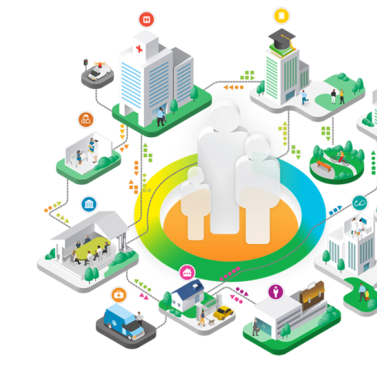
Paul Grundy MD, MPH
IBM Chief Medical Officer Director, Healthcare Transformation Healthcare Industry
Patient/Primary Medical Home
Foundation for Transformation
@Paul_PCMH

Slide 2
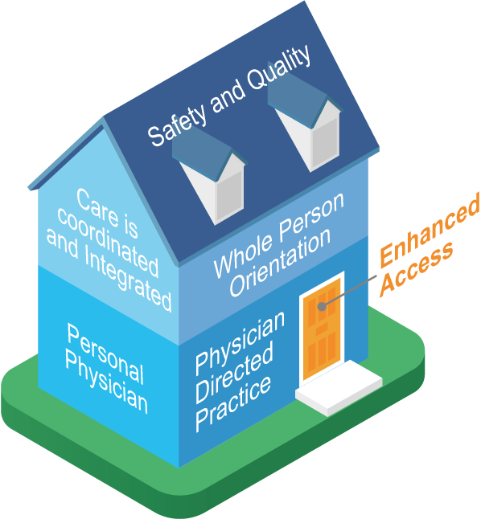
Away from Episode of Care to Management of Population with Data
Population Health
Per Capita Health
The System Integrator
Creates a partnership across the medical neighborhood
Drives PCMH primary care redesign
Offers a utility for population health and financial management
System Integrator
Patient Experience
Public Health
Community Health

Slide 4
Key principles
Personal healer – each patient has an ongoing personal relationship with a physician for continuous, comprehensive care
Whole person orientation – physician is responsible for providing all the patient’s health care needs or arranging care with other qualified professionals
Care is coordinated and integrated – across all elements of the complex healthcare community
Quality and safety are hallmarks of the medical home – Evidence-based medicine and clinical decision-support tools guide decision-making
Enhanced access to care is available – systems such as open scheduling, expanded hours, and new communication paths between patients, their physician and practice staff
Payment is appropriate – added value provided to patients who have a patient-centered medical home

Slide 5
Person & Family Centered. Primary care is focused on the whole person their physical, emotional psychological and spiritual wellbeing, as well as cultural, linguistic and social needs.
Continuous. Dynamic. Trusted, respectful and enduring relationships between individuals, families and their clinical team members are hallmarks of primary care.
Comprehensive and Equitable. Primary care addresses the whole-person with appropriate clinical and supportive services that include acute, chronic and preventive care, behavioral and mental health, oral health
Team-Based and Collaborative. Interdisciplinary teams, including individuals and families, work collaboratively and dynamically toward a common goal. The services they provide and the coordinated manner in which they work together are synergistic to better health.
Coordinated and Integrated. Primary care integrates the activities of those involved in an individual’s care, across settings and services.
Accessible. with easy, and with routine access to their health information.
High-Value. Primary care achieves excellent, equitable outcomes for individuals and families, including using health care resources wisely and considering costs to patients, payers and the system.

Slide 6
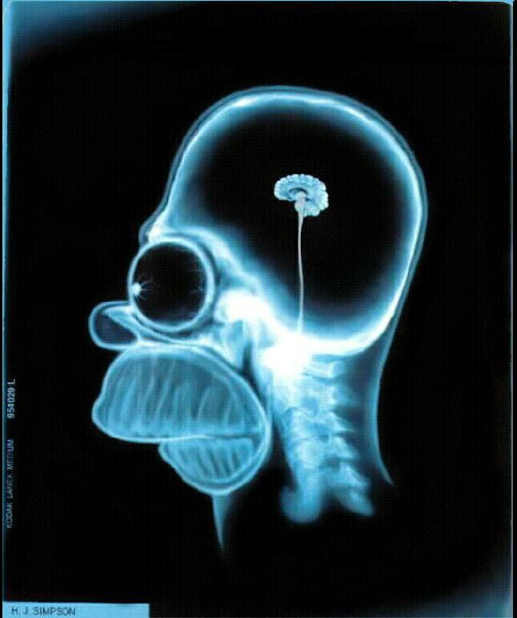
Smarter Healthcare -- a no Brainer
36.3% Drop in hospital days
32.2% Drop in ER use
12.8% Increase in chronic medication
-15.6% Total cost
10.5% Drop in inpatient specialty care costs
18.9% Ancillary costs down
15.0% Outpatient specialty down
Outcomes of Implementing Patient Centered Medical Home Interventions: A Review of the Evidence from Prospective Evaluation Studies in the US – PCPCC Oct 2012

Slide 7
24 April 2015, Michigan patient-centered medical home program shows statewide transformation of care YEAR 6
9.9% Decrease in adult ER visits
27.5% Decrease in adult ambulatory care sensitive inpatient stays
11.8% Decrease in adult primary care sensitive ER visits
8.7% Decrease in adult high-tech radiology usage
14.9% Decrease in pediatric ER visits
21.3% Decrease in pediatric primary-care sensitive ER visits
4,022 primary care doctors at 1,422 practices around the state in its sixth year of operation.
These practices care for more than 1.2 million BCBSM members.

Slide 8
Sept 2016, Michigan patient-centered medical home program shows statewide transformation of care YEAR 7
15% Decrease in adult ER visits
21.4% Decrease in adult ambulatory care sensitive inpatient stays
18.1% Decrease in adult primary care sensitive ER visits
12.7% Decrease in adult high-tech radiology usage
17.2% Decrease in pediatric ER visits
22.7% Decrease in pediatric primary-care sensitive ER visits
4,534 primary care doctors at 1,638 practices around the state in its seventh year of operation.
These practices care for more than 1.4 million BCBSM members.
http://www.bcbsm.com/content/dam/public/Providers/Documents/help/documents-forms/partners-report.pdf

Slide 9
LESSON #2
Gather together (get everyone around the table)
BCBSM’s facilitation of quarterly meetings with all PO leaders (approximately 350) has led to cross-collaboration and synergistic partnerships among providers across the state, as well as the formation of a Primary Care Leadership Committee that provides review and guidance on PGIP policies and programs.
LESSON #1
Nurture effective and stable leadership
The Physician Group Incentive Program (PGIP) has catalyzed the formation of over 40 Physician Organizations (POs) that have led and supported practices in revolutionizing the delivery of health care in Michigan.
LESSON #5
Offer meaningful financial support
The PGIP program has used a combination of incentive reward payments to POs and value-based reimbursement for individual physicians to ensure providers have the financial support needed to succeed.
LESSON #4
Demand federal commitment, action and coordination
PGIP medical leaders have testified before Congress regarding the value-based reimbursement model and the importance of the federal government supporting and recognizing regional practice transformation efforts.
LESSON #3
Spark physician enthusiasm
“Relentless incrementalism” is a PGIP motto, and PGIP initiatives are designed to support and reward step-by-step progress through the celebration of provider and program best practices at quarterly meetings.
LESSON #7
Offer technical assistance and collaborative learning
PGIP provides practices with technical assistance and opportunities for collaborative learning by hosting learning collaboratives, providing education and guidance and funding a Care Management Resource Center.
LESSON #6
Encourage multi-payer participation
The PGIP program provided the foundation for the five year Michigan Multi-Payer Advanced Primary Care Practice Demonstration program.
LESSON #8
Embrace team-based approaches that extend beyond the practice
POs and practices deliver multi-disciplinary team-based care through access to a Provider-Delivered Care Management (PDCM) program, behavioral health providers and embedded pharmacist care managers.
LESSON #10
Obtain timely, accessible and useful data
The PGIP PCMH/PCMH-N program provides financial support to POs and practices to build the capacity for population management through use of integrated patient registries and performance reporting.
LESSON #9
Establish realistic time tables for evaluation
Underlying the PGIP philosophy of relentless incrementalism is the understanding that practice transformation is a long-term process, and programs must be allowed to stabilize and mature before results are evaluated.

Slide 10
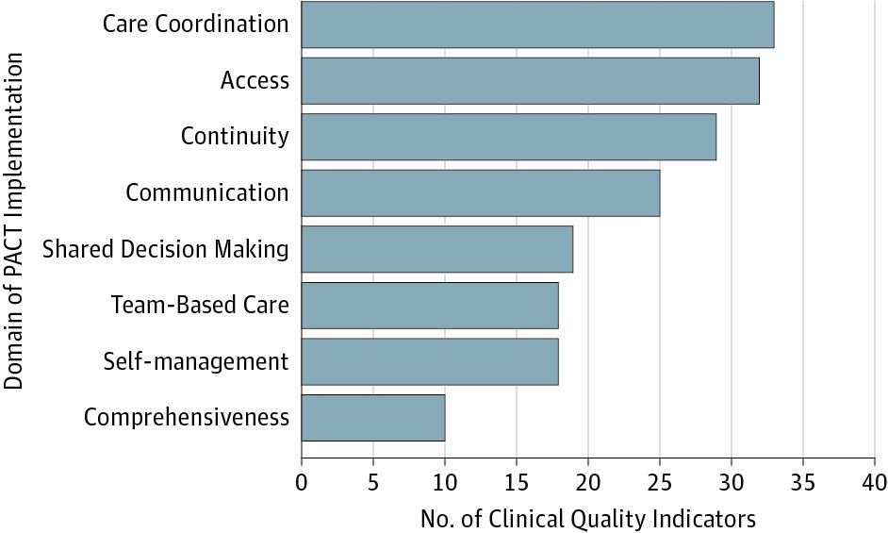
Association between elements of the PCMH model and clinical quality in the Veterans Health Admin
JAMA -May 1, 2017
http://jamanetwork.com/journals/jamainternalmedicine/article-abstract/2623525

Slide 12
Payment reform requires more than one dial
Fee for...
health
value
outcome
process
belonging
service
satisfaction

Slide 13
MAYBE WHO PAYS IS THE WRONG QUESTION
Rather
Who do we pay?
How do we pay them?
For what, exactly, are we paying?
Because the way we are paying now ineluctably drives us toward paying too much, for not enough of the right kind of care, and for things we don’t even need.

Slide 14
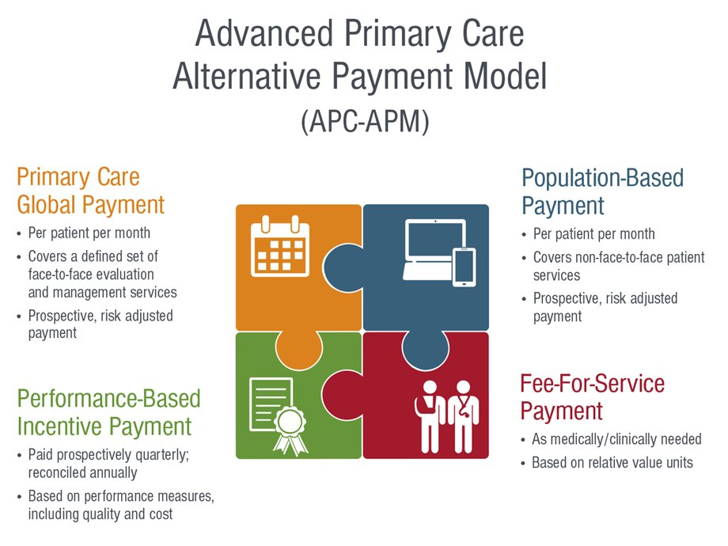

Slide 15
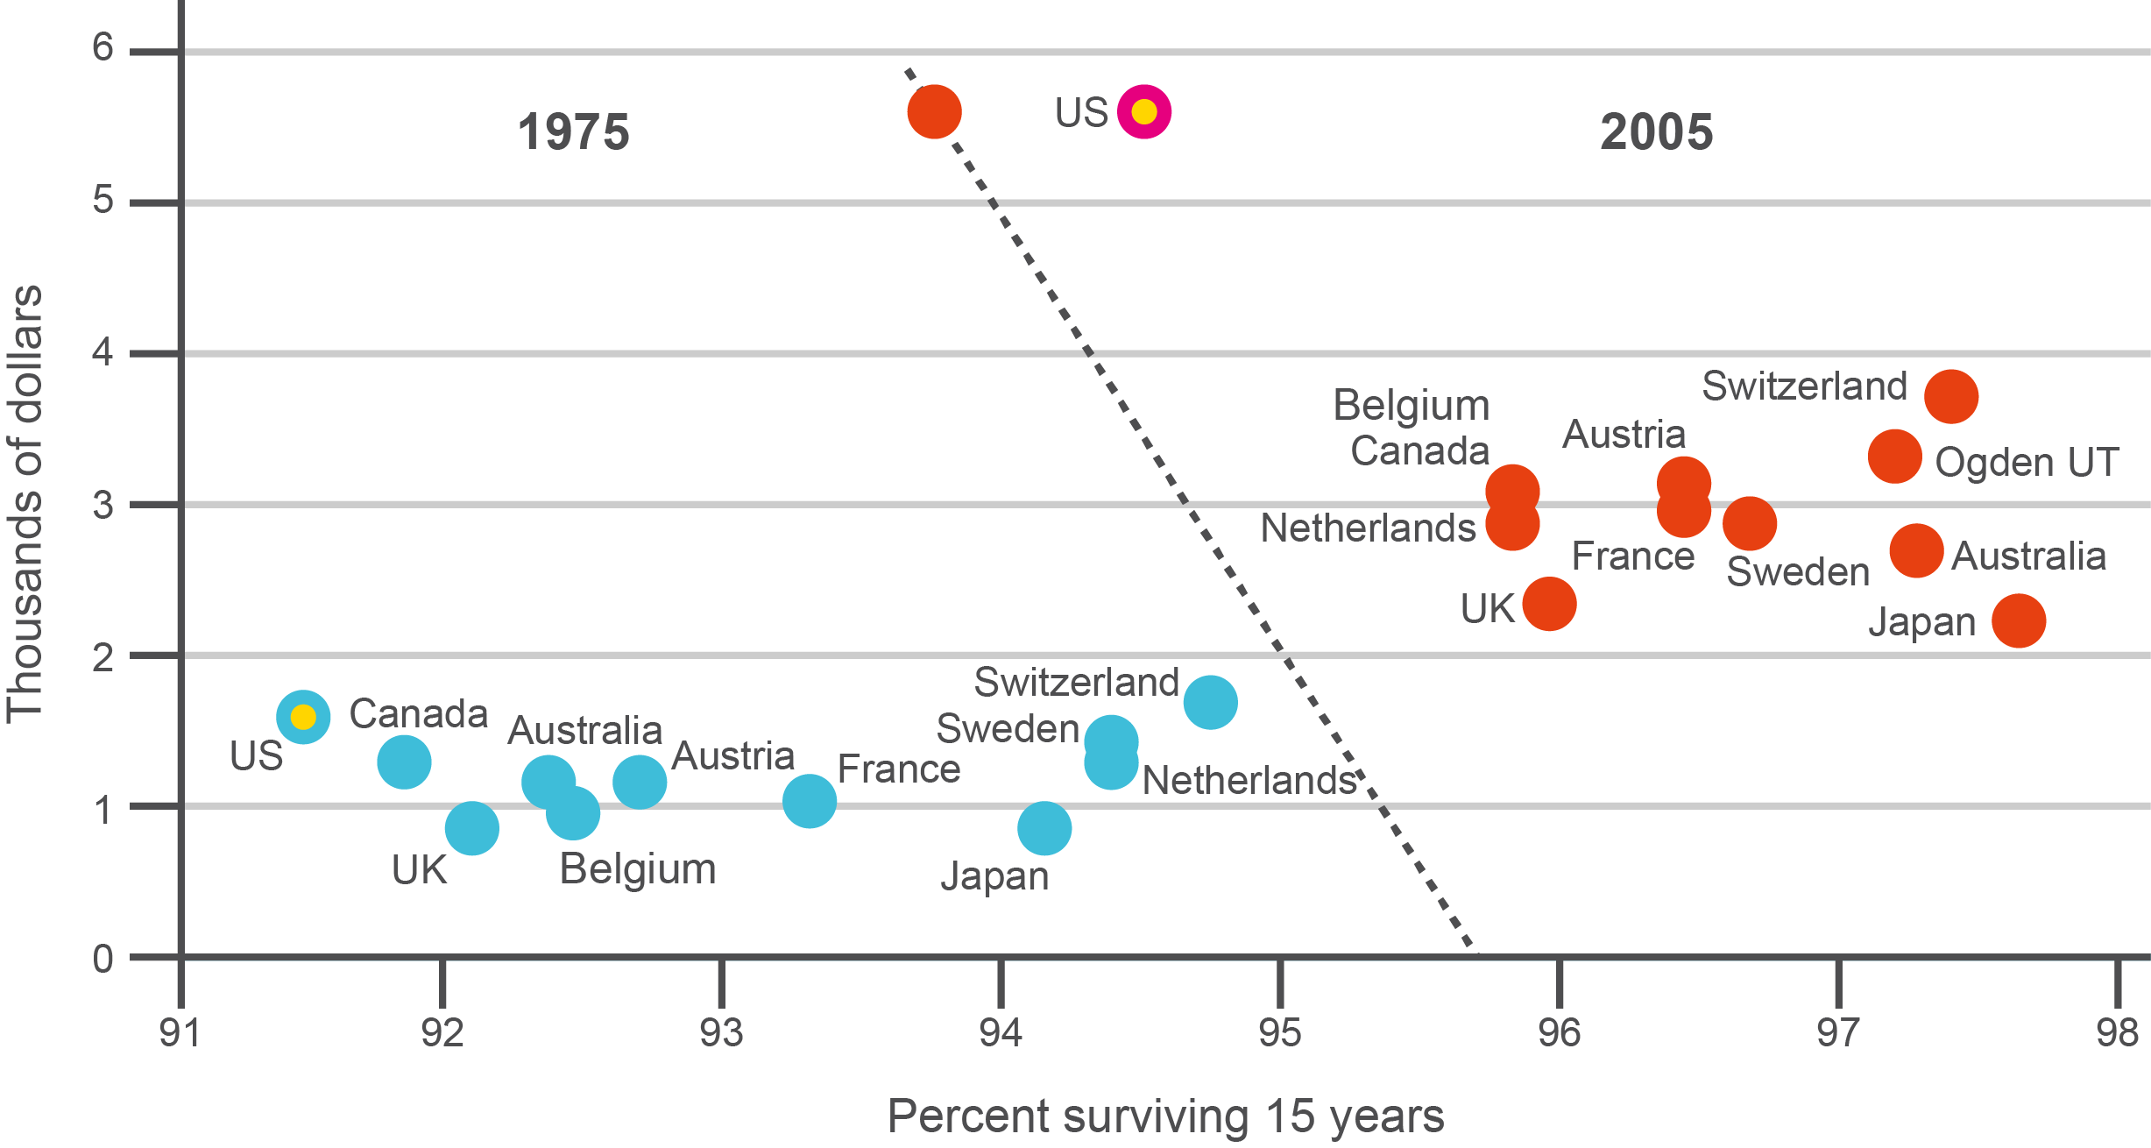
Driving factor 1: Unsustainable Cost (USA 2012)

Slide 16
Driving factor 2:
Data

Slide 17
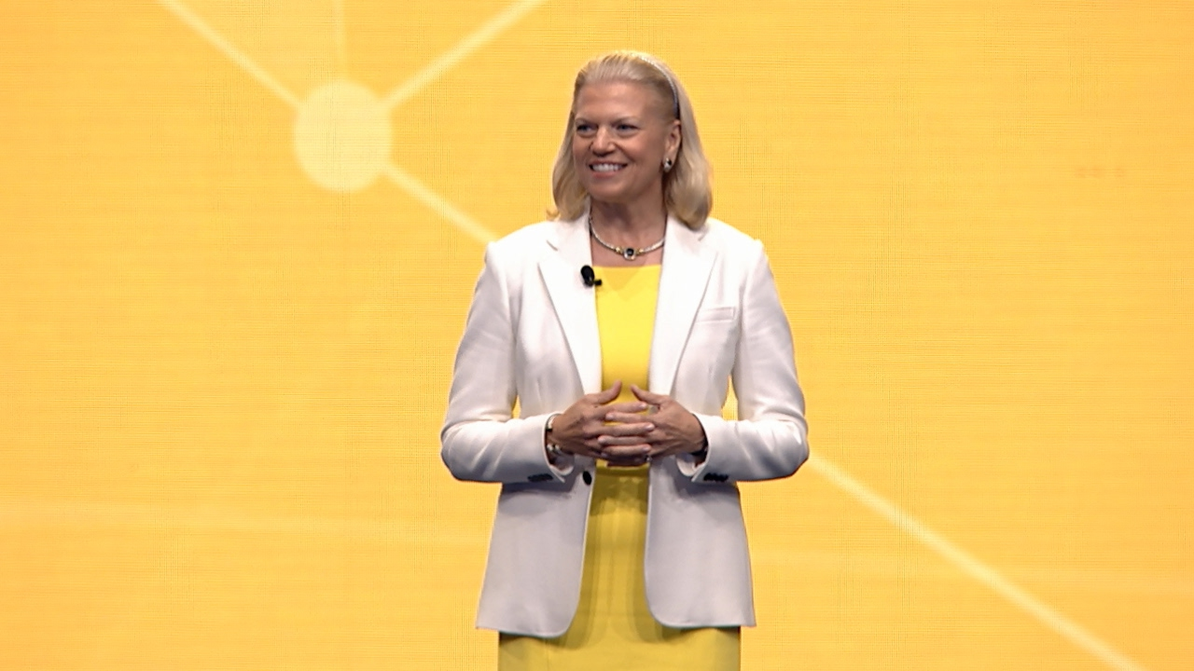
"The idea of cognitive healthcare – systems that learn – is real, and it's already mainstream," said IBM CEO Ginni Rometty in her opening keynote address to a packed auditorium at the 2017 HIMSS Convention and Exhibition. “ IT can change almost everything about healthcare."

Slide 20
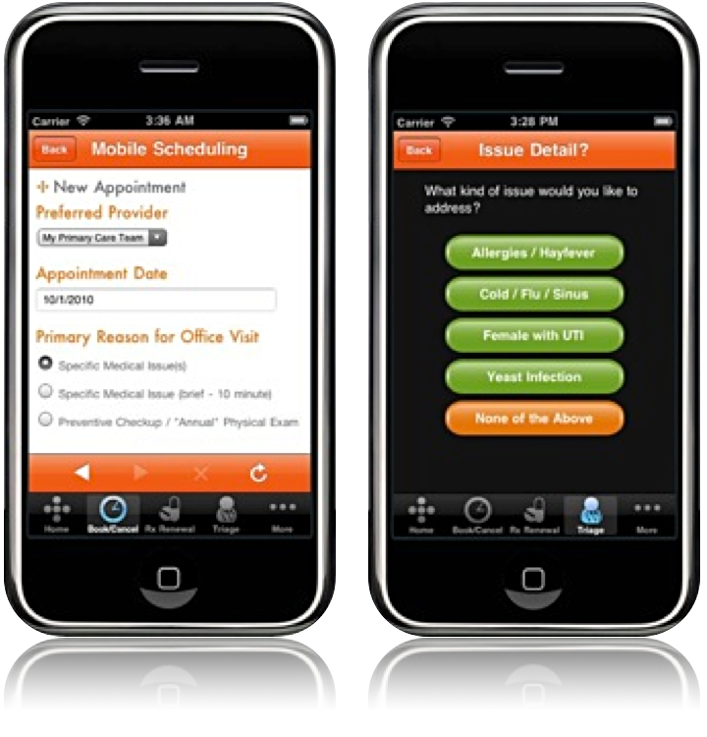
Driving factor 3:
Communication

Slide 22
Practice transformation away from episode of care
Preventive
medicine
Chronic disease
monitoring
Medication
refills
Acute care
Test results
Master Builder
Doctor
Case Manager
Behavioral health
Medical
Assistants
Nursing
Source: Southcentral Foundation, Anchorage AK

Slide 23
New model of care – putting the patient first
Chronic disease
compliance barriers
Chronic disease
monitoring
Acute mental
health complaint
Behavioral health
Test results
Case Manager
Healthcare
Support Team
Point of care testing
Medical
Assistants
Medication
refills
Source: Southcentral Foundation, Anchorage AK
Acute care
Clinician
Preventive
medicine

Slide 24
Future healthcare transformation
Data driven
Every person
has a plan
Team based
Managing a population down to the individual

Slide 26
Today’s Care
PCMH Care
My patients are those making appointments to see me
Our patients are the population community
Care is determined by today’s problem and time available today
Care is determined by a proactive plan to meet patient needs with or without visits
Care varies by scheduled time and memory/skill of the doctor
Care is standardized according to evidence-based guidelines
I know I deliver high quality care because I’m well trained
We measure our quality and make rapid changes to improve it
Patients are responsible for coordinating their own care
A prepared team of professionals coordinates all patients’ care
It’s up to the patient to tell us what happened to them
We track tests & consultations, and follow-up after ED & hospital
Source:
Slide from Daniel Duffy MD School of Community Medicine Tulsa Oklahoma
Clinic operations centre on meeting the doctor’s needs
A multidisciplinary team works at the top of our licenses to serve patients

Slide 27
Defining the care centered on the patient
Superb access to care
Team care
Patient engagement in care
Communication/
Patient Feedback
Clinical information systems, registry
Mobile – easy to use and available information
Care coordination

Slide 28
Leadership and engagement: Lighting the fire, fanning the flame
#1 effective and stable leadership
#2 rowing together
#3 the Clinician were excited
#4 meaningful financial support
#5 Including CMS/ state/ Medicaid support
#6 multipayer participation healthcare plans, employers, state, Medicaid, Medicare, HHS.
#7 technical assistance and collaborative learning
#8 team-based approaches that extend beyond the practice
#9 realistic time tables for evaluation
#10 the right tools to be able to get at accessible and useful data.

Slide 29
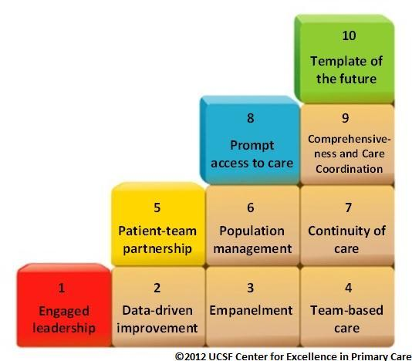

Slide 30
Benefit redesign – Patient engagement Different strategies for different Healthcare spend segments
Those with severe, acute illness or injuries
Those with chronic illness
Those who are well or think they are well
% Total healthcare spend
% of members

Slide 31
PCMH 2.0 in action
Hospitals
Community Care Team
A coordinated Health System
PCMH
Health IT Framework
Nurse Coordinator
Social Workers
Dieticians
Community Health Workers
Care Coordinators
Specialists
Global Information Framework
PCMH
Evaluation Framework
Public Health Prevention
Public Health Prevention
HEALTH WELLNESS
Operations

Slide 32
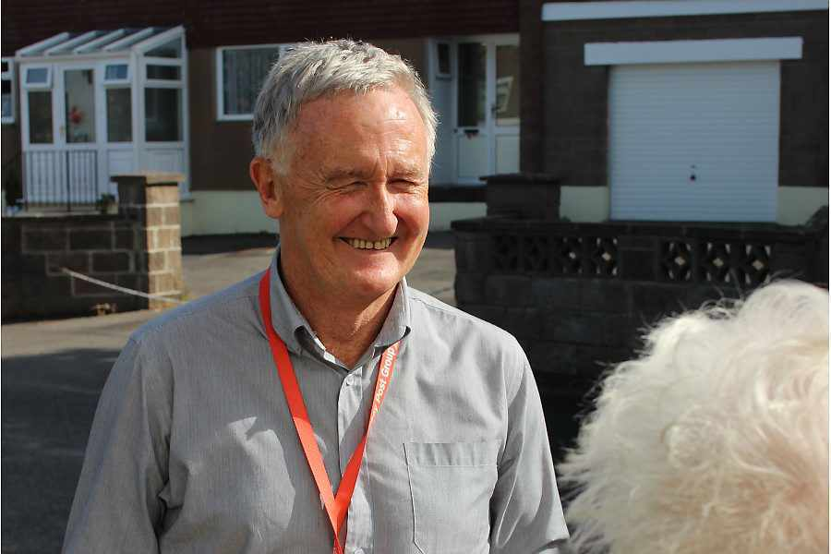
Call & Check Providing support and care for all in the community

Slide 33
12 Attributes of PCH in British Columbia
From Dr Brenda Hefford Executive Director,
Community Practice,
Quality and Integration

Slide 34
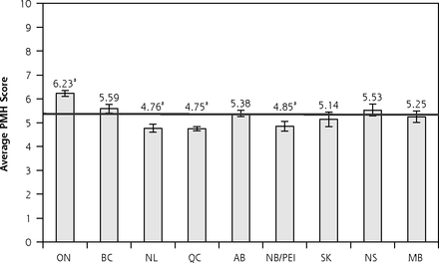
measurable indicators of the PMH model and applied them across 10 Canadian provinces. The national average PMH score was 5.63 of 10, which indicates that major work remains. Ontario was the only province to achieve a higher overall PMH score than the national average.
Alignment of Canadian Primary Care With the Patient Medical Home Model: A QUALICO-PC Study – May 2017
http://www.annfammed.org/content/15/3/230.full

Slide 35
Alignment of Canadian Primary Care With the Patient Medical Home Model The 10 Goals of the Patient Medical Home
1. Patient centered -Provide services that are responsive to patients’ and their families’ feelings, preferences, and expectations
2. Personal family physician- The most responsible provider of a given patient’s medical care Every person in Canada should have a personal
family physician
3. Team-based care Offer a broad scope of services carried out by teams or networks of clinicians; inclusive of nurses, peer physicians, and others
4. Timely access Timely access to appointments in the practice Advocate for and coordinate timely appointments with other health and medical
services required
5. Comprehensive care Provide a comprehensive scope of family practice services by working collaboratively with other professionals Address
public health needs Taking population health effects into account
6. Continuity Offer continuous care over time and in different settings Advocate on the patients’ behalf for continuity of care throughout the
health care system Preserve constant relationships and continuous medical information for patients
7. Electronic records and health information Maintain electronic medical records
8. Education, training, and research Serve as a model place for training students, residents, and other health professionals Carry out and/or
encourage staff to be involved in primary care research
9. Evaluation Carry out ongoing evaluation as part of the commitment to continuous quality improvement
10. System support Internal support through governance and management structures External support by stakeholders, the public, and other medical and health professionals and their organizations across Canada

Slide 36
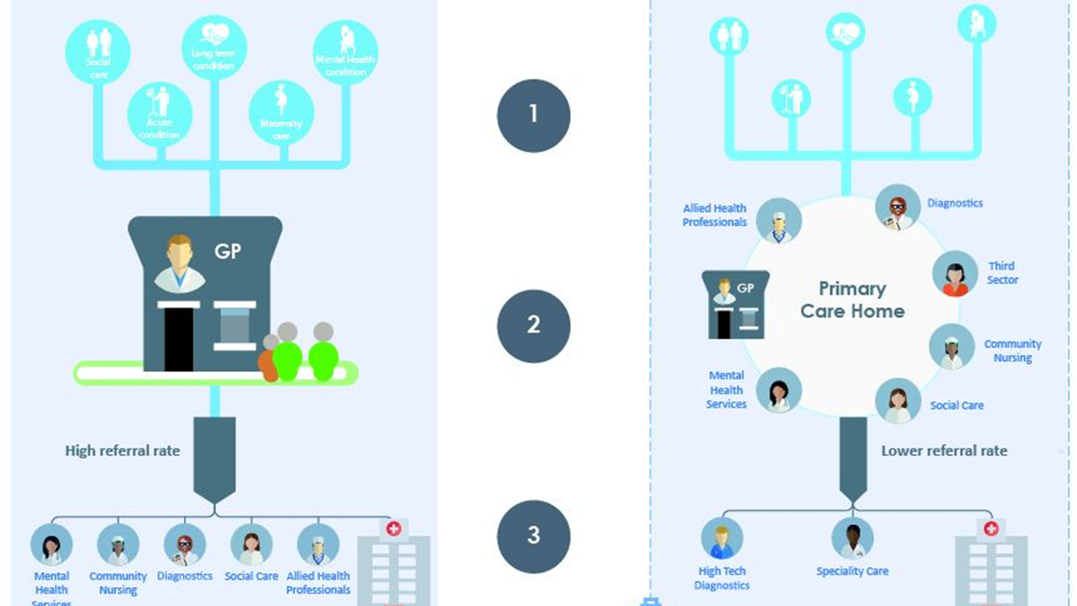
English Primary
Care Homes

