Slide 1
Appreciative Inquiry: Introduction and Key Concepts

Slide 2
Introduction to A.I.
Philosophical origins of A.I. emerge from the discipline of Positive Psychology
Development and dissemination of A.I. attributed to collaborative work of doctoral student David Cooperrider and his advisor Suresh Srivastva at Case Western Reserve University, 1980
Cooperrider & Srivastva co-author “Appreciative Inquiry in Organizational Life”, 1987

Slide 3
Definition/Primary Purpose:
A method of organizational development that focuses on what organizations do well
“Epistemology-like”
The A.I. process generates strategy for intentional change

Slide 4
Five Principles of A.I.
Constructionist: The way we know is fateful
Simultaneity: Change begins the moment you ask the question
Poetic: Organizations are an open book
Anticipatory:Deep change=change in active images of the future
Positive: The more positive the question=greater/longer lasting change

Slide 5
Key Understandings of A.I.
Appreciate/value the best of what is
Envision what might be
Engage in dialogue about what should be
Innovate what will be
A cooperative inquiry
A collaborative process
Generate new narratives/perspectives

Slide 6
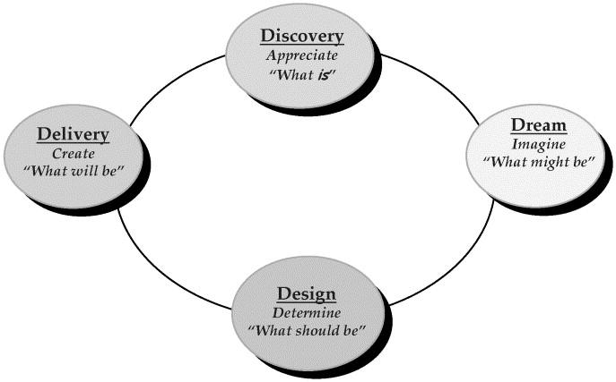
4D Cycle of A.I.

Slide 7
4D Cycle expanded
Discover: The identification of organizational processes that work well
Dream: The envisioning of processes that would work well in the future
Design:Planning and prioritizing process that work well
Destiny: The implementation of the proposed design

Slide 8
A.I. Discovery Exercise – Part 1
Find a partner
10 minutes each to share and listen to each other’s high point moment story. Take note of values of self; other, and work
Return to large group to evaluate positive outcomes

Slide 9
A.I. Exercise-High Point Moments
Share a story of when someone helped you during a time of great need.
What did they do?
How did it help you?
How did it make you feel about yourself, about them?
How did it change the way you interact with others?

Slide 10
A.I. Exercise-Challenge Moments
Describe a worst moment when you were able to step in and do what was needed to rescue the situation.
What was the situation and what did you do?
How do others describe you during that time?
What did you learn about yourself?
How have you applied that learning to other situations?

Slide 11
A.I. Exercise – Part 2
Original partners join with two other dyads to form group of 6
Introduce highlights from your partner’s interview (emphasis on positive learning)
Discuss as a group
Find common themes: Highpoints, continuity, images of the future

Slide 12
References
http://appreciativeinquiry.case.edu/intro/default.cfm
http://centerforappreciativeinquiry.net/
http://www.pgexchange.org/
Public Conversation Project http://www.publicconversations.org/blog

