Slide 1
Presenter Disclosure
Patient Engagement on Primary Care and Community Care in British Columbia – Report on Findings
Presenters: Darlene Arsenault, Director, Primary Care, Interior Health
Shannon Holms, Director, Patient Engagement and Community Programs
Relationships with Commercial Interests
- The engagement facilitation and consultation for the patient engagement sessions was done with assistance from Delaney and Associates through a contract held with the Ministry of Health Patients as Partners Program.

Slide 2
Managing Potential Bias
Shannon Holms is a Ministry of Health employee.
Darlene Arsenault is an Interior Health employee.
Assistance with the patient engagement sessions and consultation was with Delaney and Associates.
Presenting information on work that was a collaborative effort with many health sector organizations and Delaney and Associates.

Slide 3
Patient Engagement on Primary and Community Care in British Columbia Report on Findings
June 20, 2017

Slide 4
Contributing Partners and Acknowledgements
The Patient and Family Participants
Delaney + Associates
Jessica Delaney
Richard Delaney
Fraser Health
Pauline Dan (Practice Support Program)
Marie Hawkins
Fran Hensen
Kay Griffiths
Delta Division of Family Practice
Geri McGrath
GPSC/Doctors of BC
Marisa Adair
Dana Bales
Sarah Fielden
Dr. Garey Mazowita
Clare O'Callaghan
Lucas Parker
Dr. Joanne Young
Interior Health
Shelley Allan
Darlene Arsenault
Jamie Braman
Greg Cutforth
Susan Duncan
Jo-Ann Tisserand
Karla Warkotsch
South Okanagan Similkameen Division of Family Practice
Dr. Khati Henry
Vancouver Coastal Health Joanne Douglas
Carol Park
Cheryl Rivard
Ali Shukor
Ministry of Health
Sherry Bar
Shannon Holms
Emma Isaac
Sarah Plank
Moira McLean
Bethany McMullen
Patient Voices Network
Carol Stathers

Slide 5
Overview
The Rationale
The Purpose of the Engagement
The Structure of the Engagement
Results
Engagement Feedback
Next Steps
Photo: Patient Engagement Session
Notes:
The Purpose of the Engagement
What was the purpose of the engagement, and what questions were we seeking to answer?
Results
What were the results that we received?
Next steps
How will the information be used?

Slide 6
The Rationale
Why engage now?
Patient centered approach
Identified need from different groups
System level collaboration
Notes:
Why engage now?
Patient centered approach
Involving patients at the beginning is truly patient centered
Identified need from different groups
The PMH expectations task group, the Patients as Partners Program team, GPSC and MoH communications groups, and the GPSC evaluation team all had identified a need to have patient engagement on a short timeline to inform their work.
System level collaboration
By working as a system and leveraging our strong relationships that we have together, we were able to work collaboratively to great success.

Slide 7
Purpose of Engagement
To include patients, their families, communities and stakeholders in the development of a new approach to accessing primary and community care that’s understandable to patients and the public.
Notes:
“The patients were to look at the public facing aspect of the strategy. We are not shifting technical language or changing the strategy based on the patients’ input, but rather, trying to determine what language and concepts would resonate with the public and patients. The patient proposition is to ensure that we pursue the patient’s voice, choice and representation in the healthcare sector improvements that we are embarking upon.

Slide 8
Purpose of Engagement
Four topics:
How do we describe our renewed vision of primary care, including the Patient Medical Home/Primary Care Home, so that it’s understandable to patients and the public?
What are your impressions of the way care will be provided in the renewed system?
Based on your experience, how do patients and families want to access primary care?
What’s important to you as a patient to measure the success of the Patient Medical Home, and primary and community care system, going forward?

Slide 9
Structure of the Engagement
Workshop format (polls, surveys, paired interviews and small group discussions), facilitated by Delaney + Associates
Representation from the Ministry of Health, Doctors of BC, GPSC, Divisions of Family Practice, clinicians, Patient Voices Network, the Practice Support Program and health authority staff.
Three sessions (n=47):
Vancouver, Surrey, Kelowna
Photo: Patient Engagement Session
Notes:
Workshop format, facilitated by Delaney + Associates
Representation from the Ministry of Health, Doctors of BC, GPSC, Divisions of Family Practice, clinicians, Patient Voices Network, the Practice Support Program and Health Authority staff.
Three sessions held in January 2017
Vancouver, Surrey, Kelowna
Although there were 23 patients in attendance in Kelowna, 13 in Surrey and 9 in Vancouver representing a fairly diverse group of 47 people (men, women, younger, older, multicultural populations, indigenous populations, caregivers, those with chronic complex health and mobility issues from rural and urban centers), the group was not representative of British Columbians generally. It lacked representation from larger numbers of men, younger patients and people who have not had frequent experience with the health care system.

Slide 10
Structure of the Engagement
Patients were recruited to ensure we had representation from various groups (33 from Patient Voices Network; 14 from other groups):
Attached/unattached
Rural, remote, urban
Family caregivers
Different Socioeconomic statuses and cultural groups
Different age and gender groups
Aboriginal representation
Among the patients recruited, we had participants representing other groups:
Those who have recently had surgery or need surgery
Those with mobility issues
Those with chronic and/or complex medical conditions
Those with lived experience of addiction
Those living with a mental health condition
Notes:
1/3 of these folks have never been engaged on this topic

Slide 11
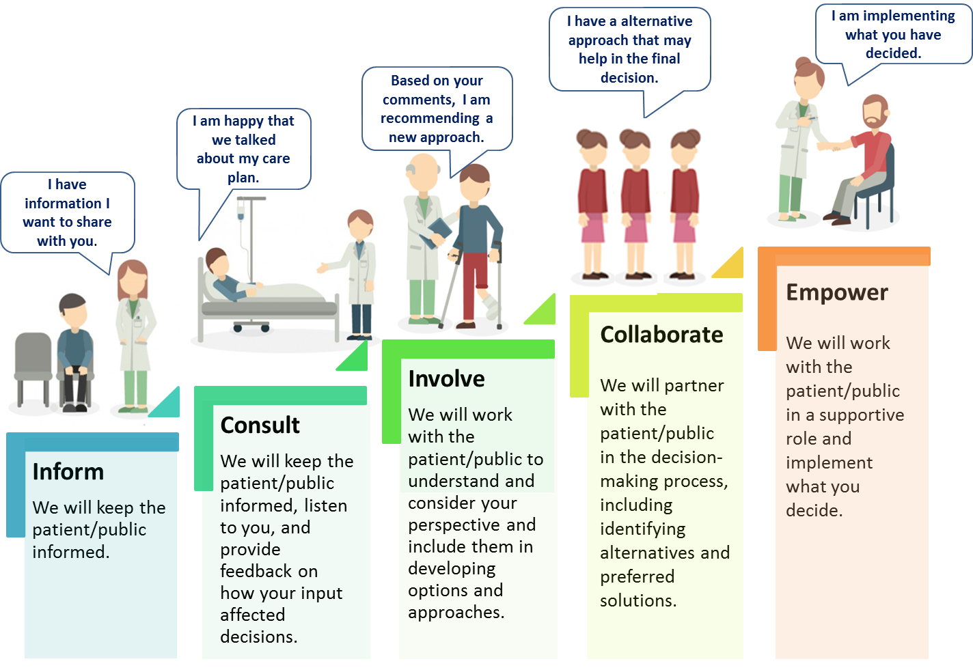
Structure of the Engagement
An Engagement Framework for Patient, Family, Caregiver and Public in Health Care
Individual – direct care from physicians, team based care and other providers plus self management strategies.
Community – programs and services.
System – policy, planning and governance.
Levels of Engagement
Types of Engagement
Developed by Shannon Holms, Director, Patient as Partners program, May 2017 Draft 6 for consultation

Slide 12
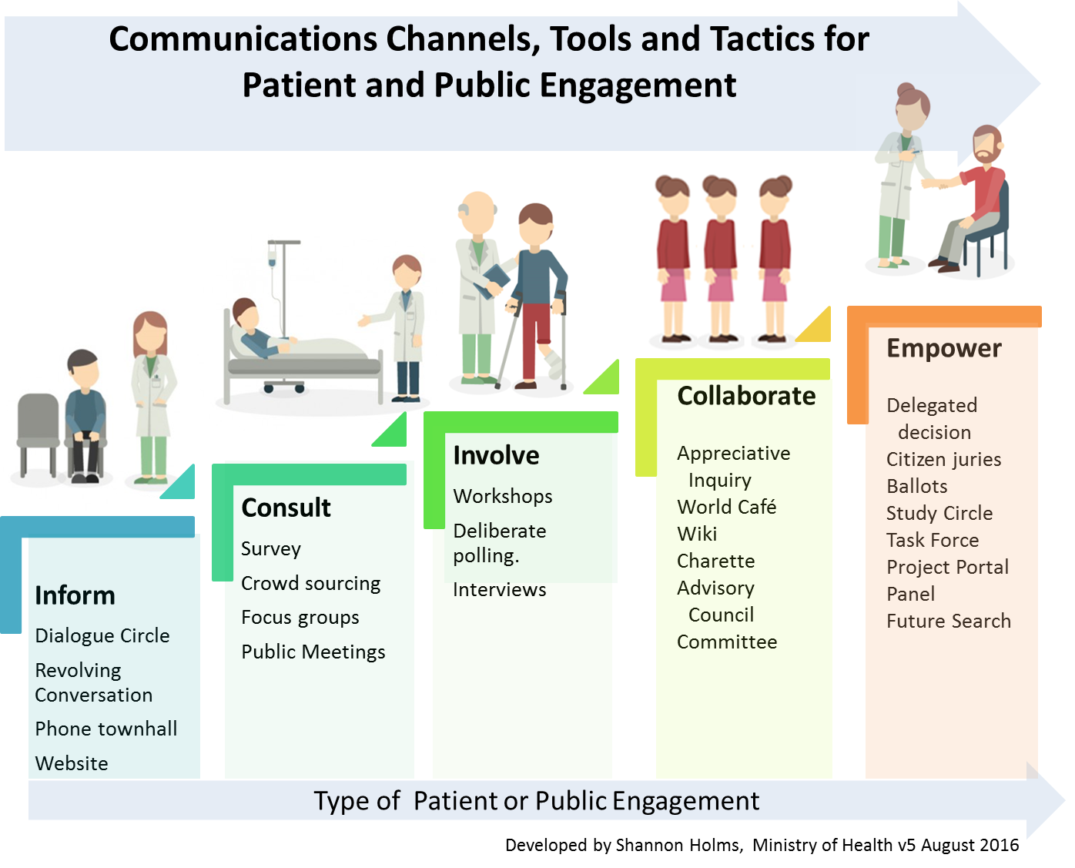
Approach for the Engagement
Individual – direct care from physicians, team based care and other providers plus self management strategies.
Community – programs and services.
System – policy, planning and governance.
Levels of Engagement
Developed by Shannon Holms, Director, Patient as Partners program, May 2017 Draft 6 for consultation

Slide 13
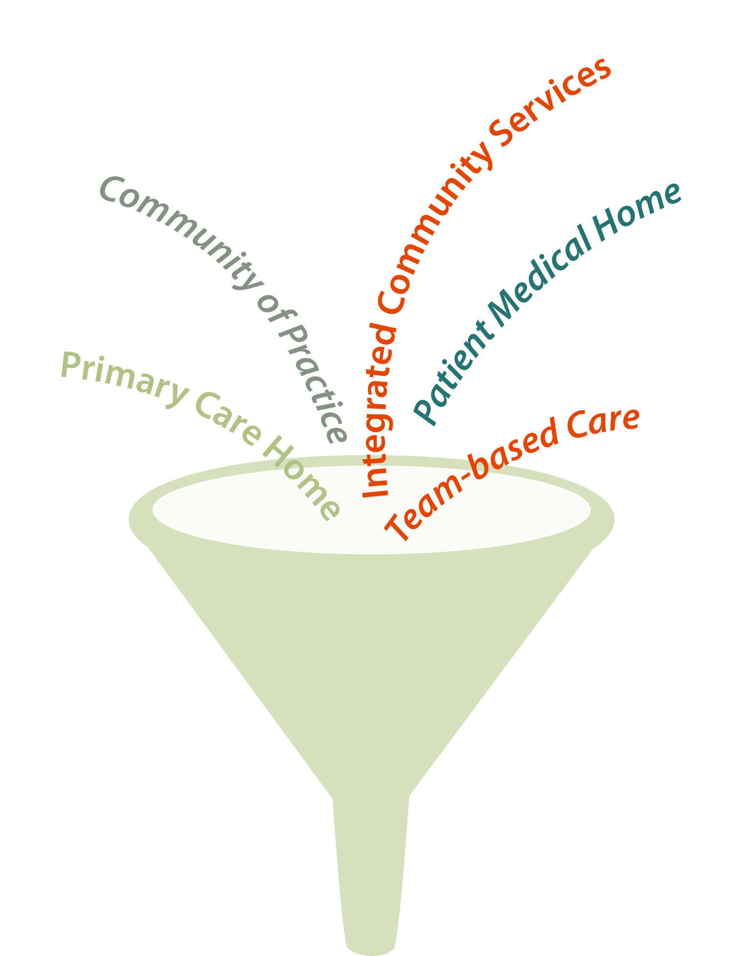
Engagement Results
How do we describe our renewed system of primary care, including the Patient Medical Home/Primary Care Home, so that it’s understandable to patients and the public?

Slide 14
Engagement Results
Participants found the use of the word “home” to name both models confusing.
Many participants thought that the word “home” shouldn’t be used.
When asked to suggest a name, most suggested a three-word label with “care” as the middle word.
Though there was no consensus on what name would be best, the term ‘Patient Care Network’ to describe the whole system had the highest score.
Notes:
Participants were then asked to comment on the names. A strong majority of participant do not prefer (“hate it”, “terrible name”, “creates confusion”) the names Patient Medical Home or Primary Care Home, because:
does not describe the model as it has been presented
“home” is a facility not a group of people
a “patient home” is for retired people or people close to end of life (nursing)
is meaningless and / or misleading
the names are too similar to distinguish
The most popular words suggested include: Patient, Health, Network, Team

Slide 15
Engagement Results
What do you think of the way care will be provided in the renewed system?

Slide 16
Engagement Results
Initially, the participants found the patient medical home and the primary care home models very confusing
Once understanding was reached, participants embraced the proposed system of care
Patients stressed that the most important aspects of primary care are “human factors”
A word cloud indicating the popularity of the word used to describe what is most important between the participant and their care provider.
Notes:
Though participants have a high degree of health literacy, 38% still did not understand the Patient Medical Home/Primary Care Home models after receiving a context setting presentation and asking a subject matter expert questions, which suggests there is an opportunity to be much clearer in the policy direction.
Initially, the participants found the models very confusing
Once understanding was reached, participants embraced the proposed system of care, though there were some concerns about implementation of the model
Patients stressed that the most important aspects of primary care are “human factors
The patient groups agreed that the models of care would meet their primary health care needs and those of their family, though there were some technical, professional culture and political /financial concerns about the successful implementation of the model.
The most important aspects of primary care are “human factors” such as: compassion, “bed-side manner”, providing comfort, feeling valued, respected and treated in a non-judgmental way.
A word cloud indicating the popularity of the word used to describe what is most important between the participant and their care provider.

Slide 17
Engagement Results
People were supportive of receiving primary care from a nurse, nurse practitioner or from a team of providers as well as their traditional primary care provider.
Participants had concerns and would need reassurance about confidentiality, co-ordination and communication when receiving team-based care.

Slide 18
Engagement Results
Based on your experience, how do you want to access primary care?

Slide 19
Engagement Results
Patients want to be able to speak with a medical professional over the telephone on the same day.
A friendly, helpful real person when I call
Patients want to physically meet with a provider within one to three days.
Other priorities included:
To be treated with respect
The right care at the right time (i.e. urgent care when it’s urgent)
My records are available to the person I see
Competency
Confidentiality
Timely test results
Notes:
Participants have graduated expectations for timely access to primary care practitioners. They place a high value on being able to speak with a medical professional over the telephone on the same day, during regular office hours and to physically meet with a provider within a relatively short time (1-3 days).
Other priorities included:
The right care at the right time (i.e. urgent care when it’s urgent)
My records are available to the person I see
Confidentiality
Timely test results
A friendly, helpful real person when I call
To be treated with respect was mentioned frequently in response to this question.

Slide 20
Engagement Results
What does success look like? How can we evaluate your experience with the Patient Medical Home?
Photo: Patient Engagement Session
Notes:
The first part of the engagement focused on the primary system of care which contains the patient medical home, the primary care home (now called networks), specialized services, the health authorities wrapped around the patient and their families. The second part of the engagement session focussed on evaluating the patient medical home.

Slide 21
Engagement Results
Measuring my ability to access care and how my care provider communicates with me and others is important.
Other important indicators to measure performance included:
If patients have access to a regular health care provider.
What barriers exist that prevent a patient from having a regular care provider.
Barriers to accessing care in general, like transportation and language barriers.
Notes:
Participants felt strongly that measuring access and communication were important to evaluate the success of the Patient Medical Home model. Please note the system of primary care was not part of the evaluation conversation at this time.
Other selected indicators to measure performance of the patient medical home included:
If patients have access to a regular health care provider
What barriers exist that prevent a patient from having a regular care provider
Barriers to accessing care in general

Slide 22
Engagement Results
What does good care feel like?
The vast majority of participants said they felt valued as a person, followed by cared for. The words nurtured, safe and protected were also used.
What is observable when receiving good care?
I was the focus. The provider was looking at and listening to me.
There was a plan.
There was good communication.
They took the time to comfort and reassure me.
I could see there was someone in charge, coordinating my care.
Notes:
4. How can we evaluate your experience with the Patient Medical Home?
What does good care feel like?
The vast majority of participants said they felt valued as a person, followed by cared for. The words nurtured, safe and protected were also used.
What is observable when receiving good care?
I was the focus. The provider was looking at and listening to me.
I was told what would happen (there was a plan) and it happened on time.
There was good communication between me and the providers and with my family.
They took the time to comfort and reassure me.
I could see there was someone in charge, coordinating my care.

Slide 23
Engagement Results - Conclusions
Participants supported the proposed model of care delivery, but some were cautiously optimistic it could be implemented.
Overwhelmingly participants do not like the use of the word “home” in both models: patient medical home and primary care home.
When choosing from a list, accessibility and timely access are the most important measures of success.
However, during open discussion the human elements of care were prioritized higher than access.
Being able to spend more time with their provider was also consistently identified as one of the most important aspects of primary care.
Notes:
Participants generally believe the proposed model of care delivery will meet their care needs and the needs of their family
Overwhelmingly participants do not like the use of the word “home” to describe either model
When choosing from a list, accessibility and timely access are the most important measures of success for the new system of care model.
However, during open discussion the human elements of care were prioritized higher than access.
Being able to spend more time with their provider was also consistently identified as one of the most important aspects of primary care.

Slide 24
Engagement Feedback
Very well received by the patient participants.
They appreciated being engaged at the front end.
Photo: Patient Engagement Session
Notes:
Patients were very positive about the idea of team based care. They were also very grateful to be engaged at the front end of the planning work.

Slide 25
Next Steps
How will the information be used?
Planning for future engagement.
Building on our system level collaboration.
Photo: Patient Engagement Session
Notes:
The information that we obtained from the patient engagement sessions will be used in our future planning and some of the policy work being done right now.
The health authorities are being more purposeful around patient engagement with their local and regional work, such as the Collaborative Services Committee and Interdivisional Strategic Councils.
The Ministry is planning regional engagement tables in the coming months. Some of the work being done in this area may serve us for as topic for engagement.
The Ministry is working on an overarching communications/engagement plan for the priority work.
Building on our system level collaboration – we will continue to collaborate with our partners.
Answer after consultation with the comms groups

Slide 26
Questions?
Photo: Patient Engagement Session
Shannon Holms | Director, Patient Engagement and Community Programs
Primary and Community Care Policy Division | Ministry of Health
Phone: 250.952.2301 | Cell: 250.507.2490
Or contact your local health authority lead

