Slide 1
PMH/PCH
in the
Kootenay Boundary
Dr David Merry, Board Chair
Andrew Earnshaw, Executive Director

Slide 2
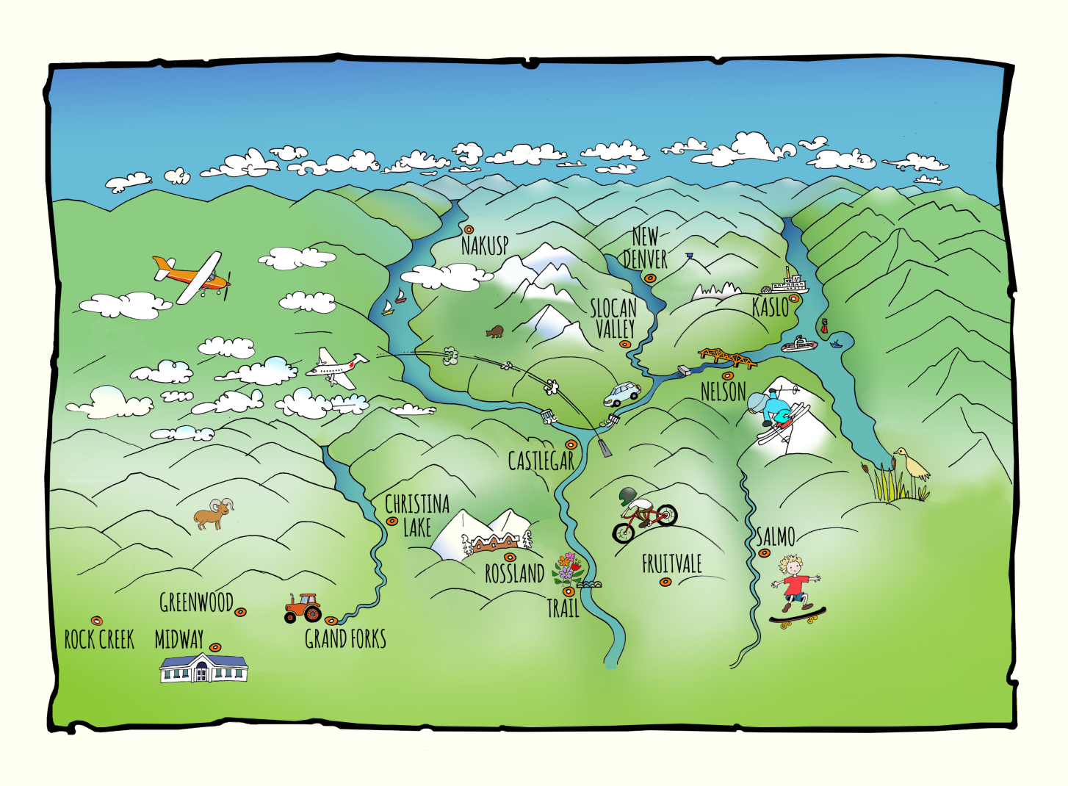
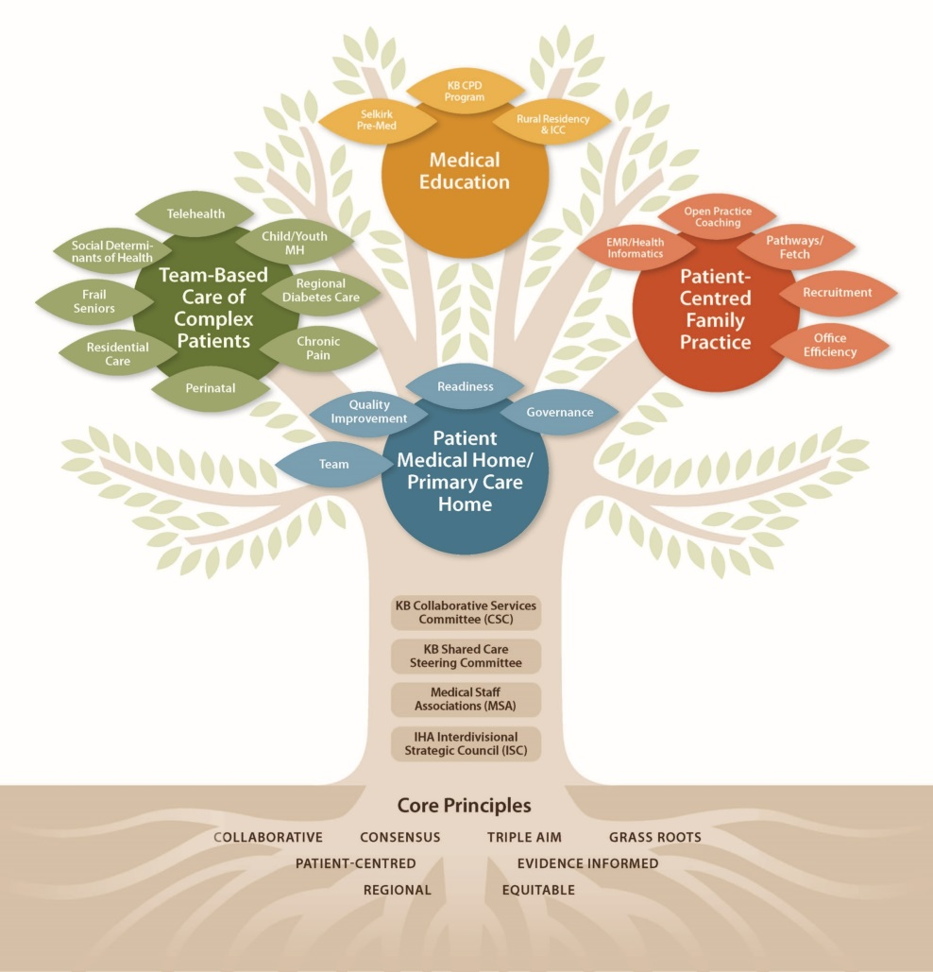
Notes:
Quick overview of KB – What we call the “Original” Rural and Remote Division
80,000K pop, Physician clinics and IH staff spread throughout 13 culturally distinct communities, five dominant regions, four GSAs
Tree: 6th full year of Division Operations. Since inception, over 30 independent system improvement Projects and Programs – “the leaves on our tree”

Slide 3
Our PMH/PCH Journey
Spring 2015 MoH Policy Papers opportunity recognition* promotion
Fall 2015 CSC Leadership Commitment
Division AGM & Northern Health “road show”
Winter 2016 QI Discussion Paper
Spring 2016 Engagements
Fall 2016 Proof of Concept designation & subsequent funding
Notes:
I’m going to start with a quick overview of the journey, before we spend most of my time showing you a handful of slides that focus on the “Why” behind each of these steps.
[Read Slide… but be quick about it…]

Slide 4
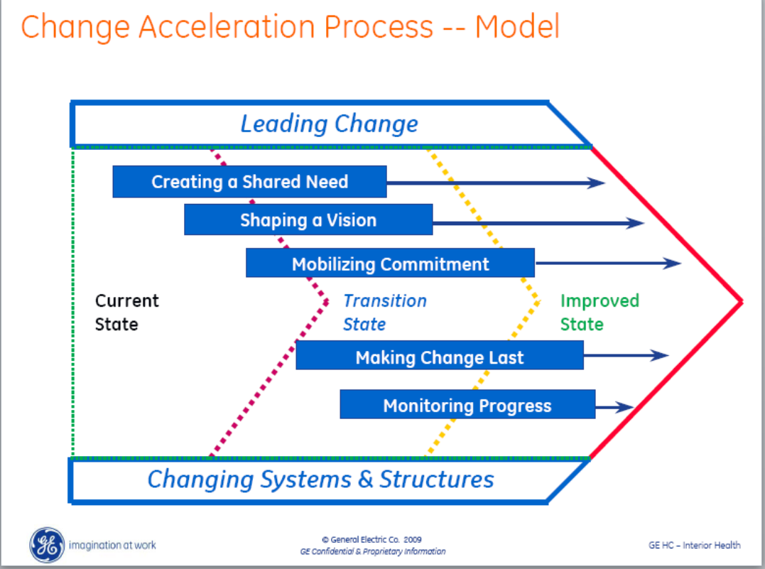
Notes:
There are 2 key “technologies” that I’m going to start with.
The first is Change Management.
This is GE’s Change Acceleration Model (lots of other good one’s are out there – but this IHA’s, so we use it too)
Key element is the first bar: Creating a Shared Need.
Without it, nothing proceeds

Slide 5
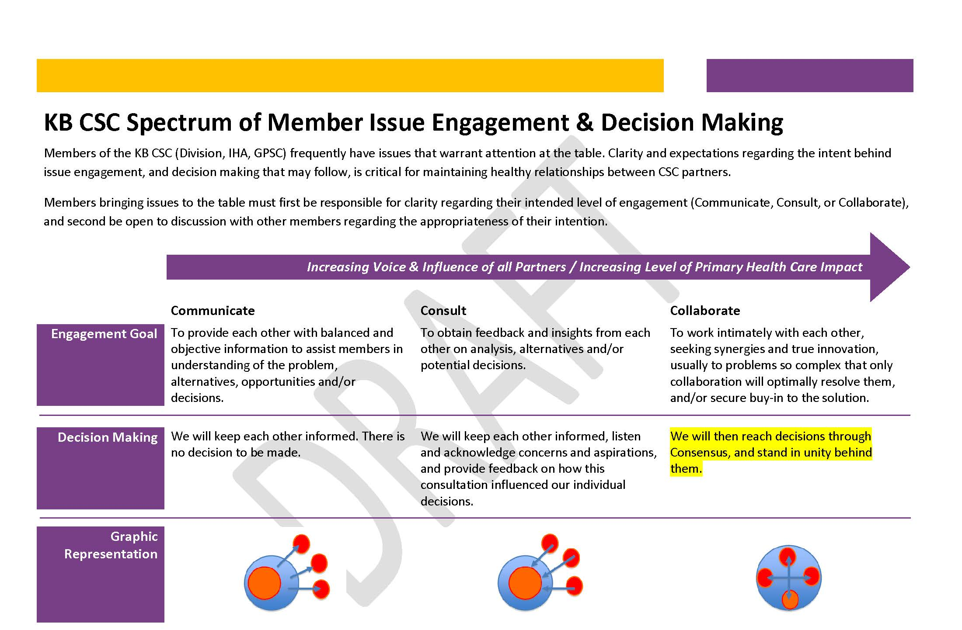
Notes:
And almost as important to us as Change Mgt., our number 2 “technology”, Engagement Theory
This is a “KB model” of Engagement we plagarized from IAP2 (International Association of Public Participation)… but the basic tenants are the same:
Be absolutely clear with people why you are engaging, what you control, and what they can influence, and they won’t get frustrated.
So remember Change Management and Engagement Theory as I talk a bit more about the steps we’ve taken.

Slide 6
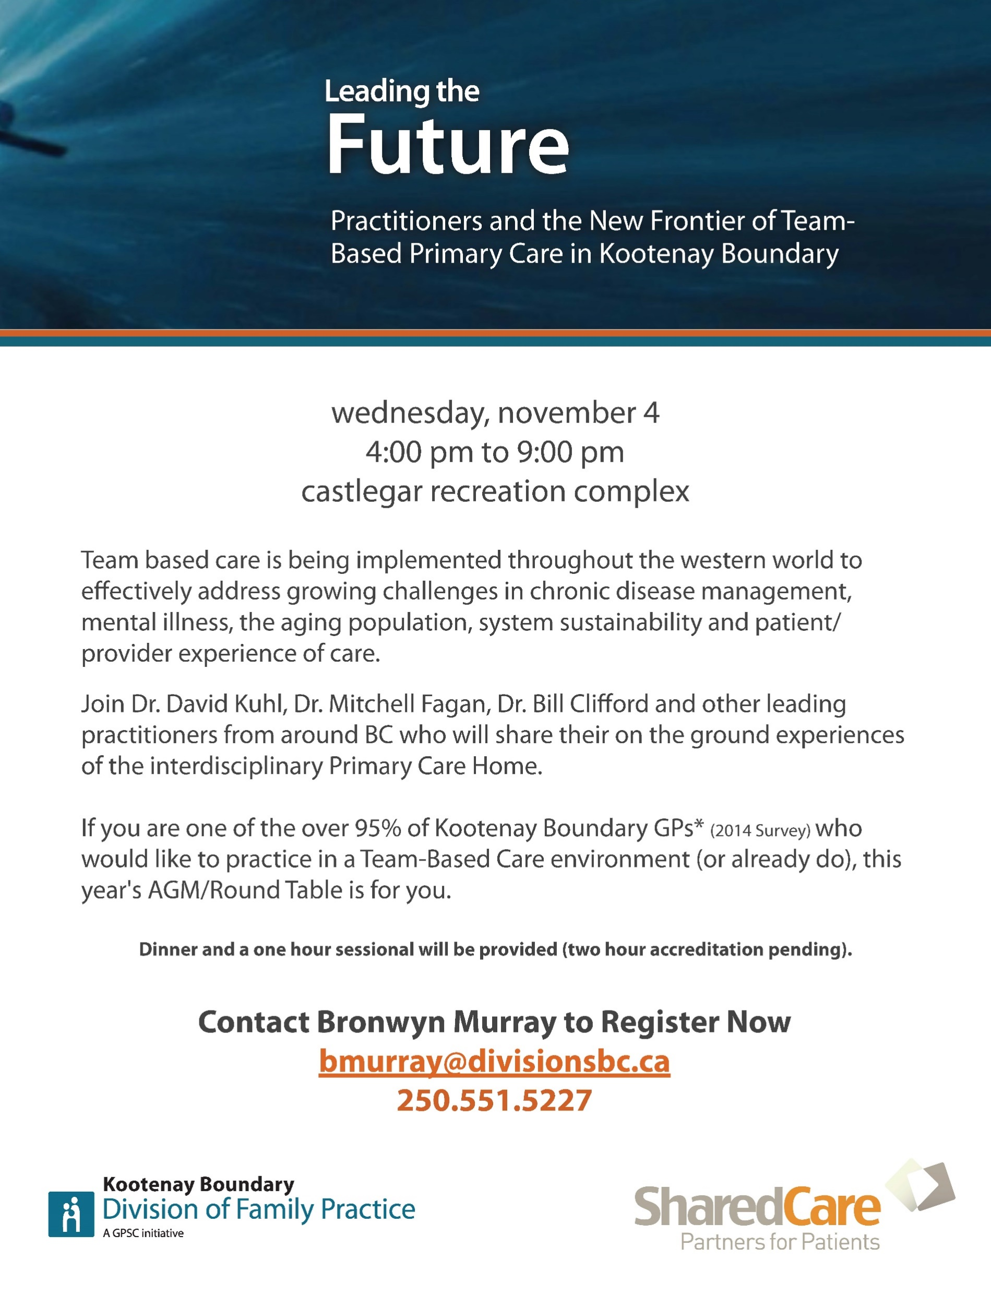
Notes:
I’ve already mentioned our “seizing the opportunity” of the MoH Policy Papers, so I’ll start with our AGM in the fall of 2015.
We purposefully chose the Northern team of the Prince George Division and their Northern Health Authority colleagues, as they are well known for being both ahead of the province, and highly collaborative.
And we seized the opportunity of bringing them all the way here to our AGM, to add an extra day to their trip and tour them to three different communities where they spoke to Physicians, IH staff and Community Leaders, all in the same room.

Slide 7
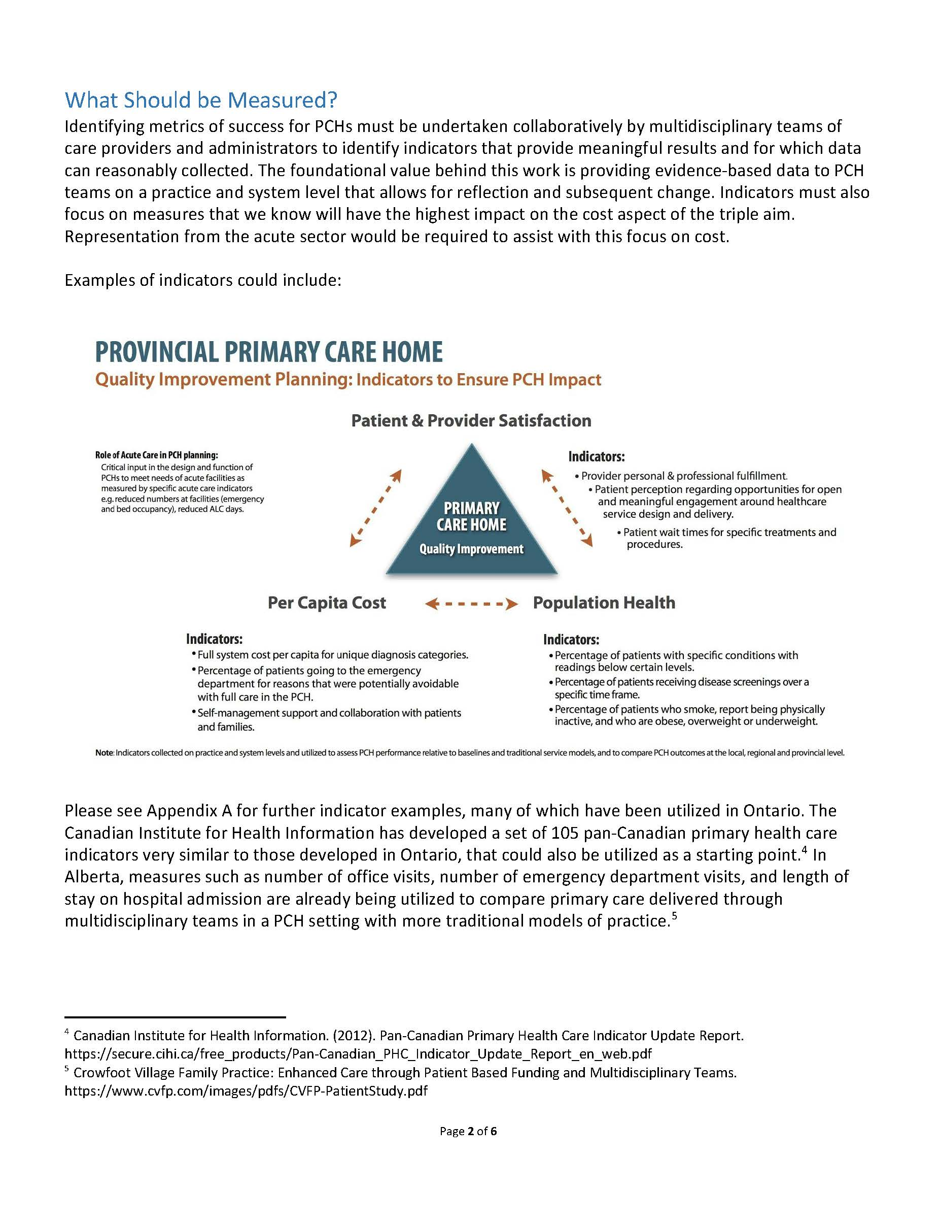
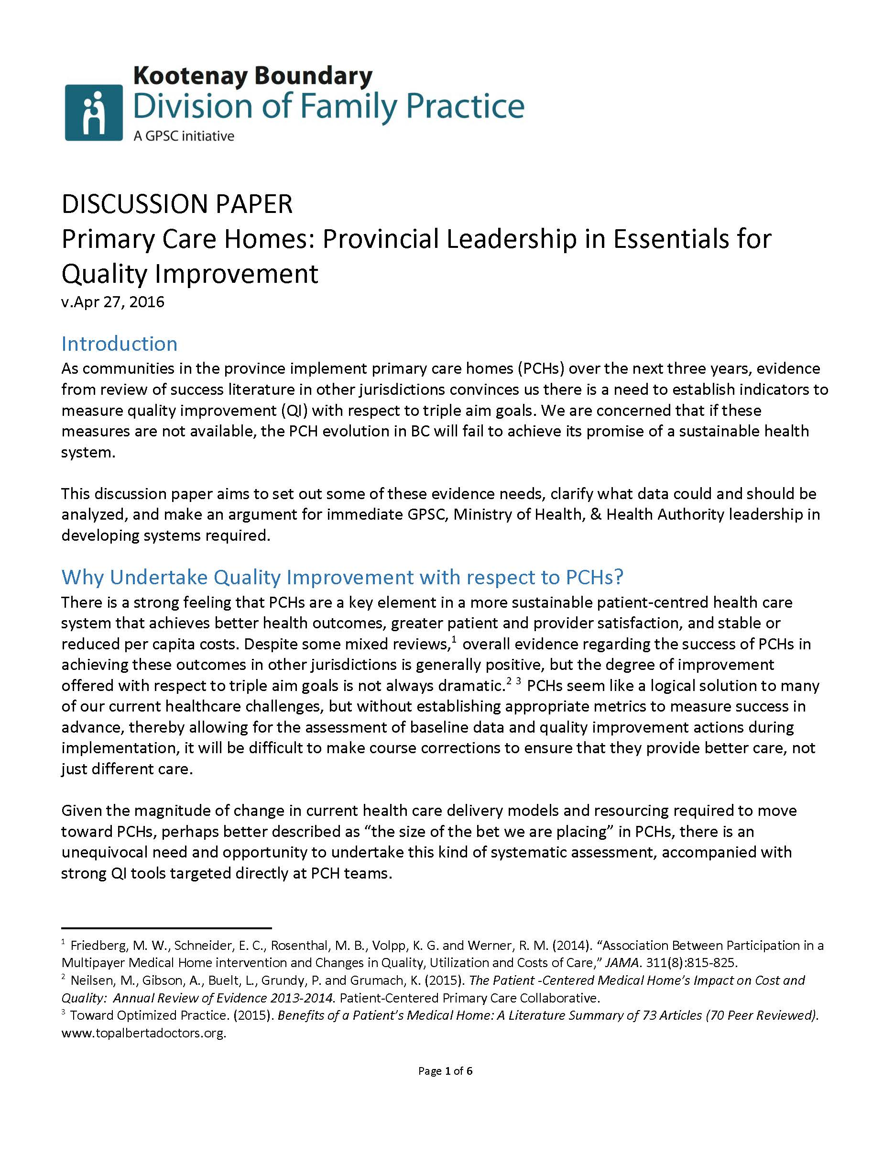
Notes:
And now our Discussion Paper on QI.
We were motivated to write this based on our disappointment at the lack of promised evaluation data from the GPSC Res. Care project, and our learning from the US experience that were Patient Medical Homes don’t have rigorous QI, they fail to produce results.
The paper makes the case for Provincial Leadership in providing the necessary data.
However, the real lesson learned for us in this is the way in which this paper has been a door opener for us.
We’ve pitched it to anybody who will listen, and not only advanced an important issue, but also positioned ourselves as leaders in a realm where lots of leadership is being sought.

Slide 8
Feb 2016 CSC Retreat – Working ?’s
What do we want from this stakeholder, long term?
Based on “1.”, what initial engagement (next 3 months) does this stakeholder need?
    What’s the existing level of awareness of this group?
    What are the key messages?
What pitfalls must be avoided (fears, concerns, expectations to be managed)
What Champions (/Key Informants) should be engaged first?
Notes:
These are the questions we started with at our yearly CSC retreat, early this year, thinking about all the local, regional and provincial Stakeholders we needed to engage to advance the Primary Care Home.
The reason I show you these is to emphasize the need to consider, and be in relationship with, everybody who may have influence over change in your communities.
In addition to this conversation kicking off planning for our local engagements, we took the results of this work and developed a communications strategy for decision makers in Kelowna, Vancouver and Victoria.
Equally important, you can imagine how an exercise like this built cohesion, trust and a sense of “common cause” at our local CSC.

Slide 9
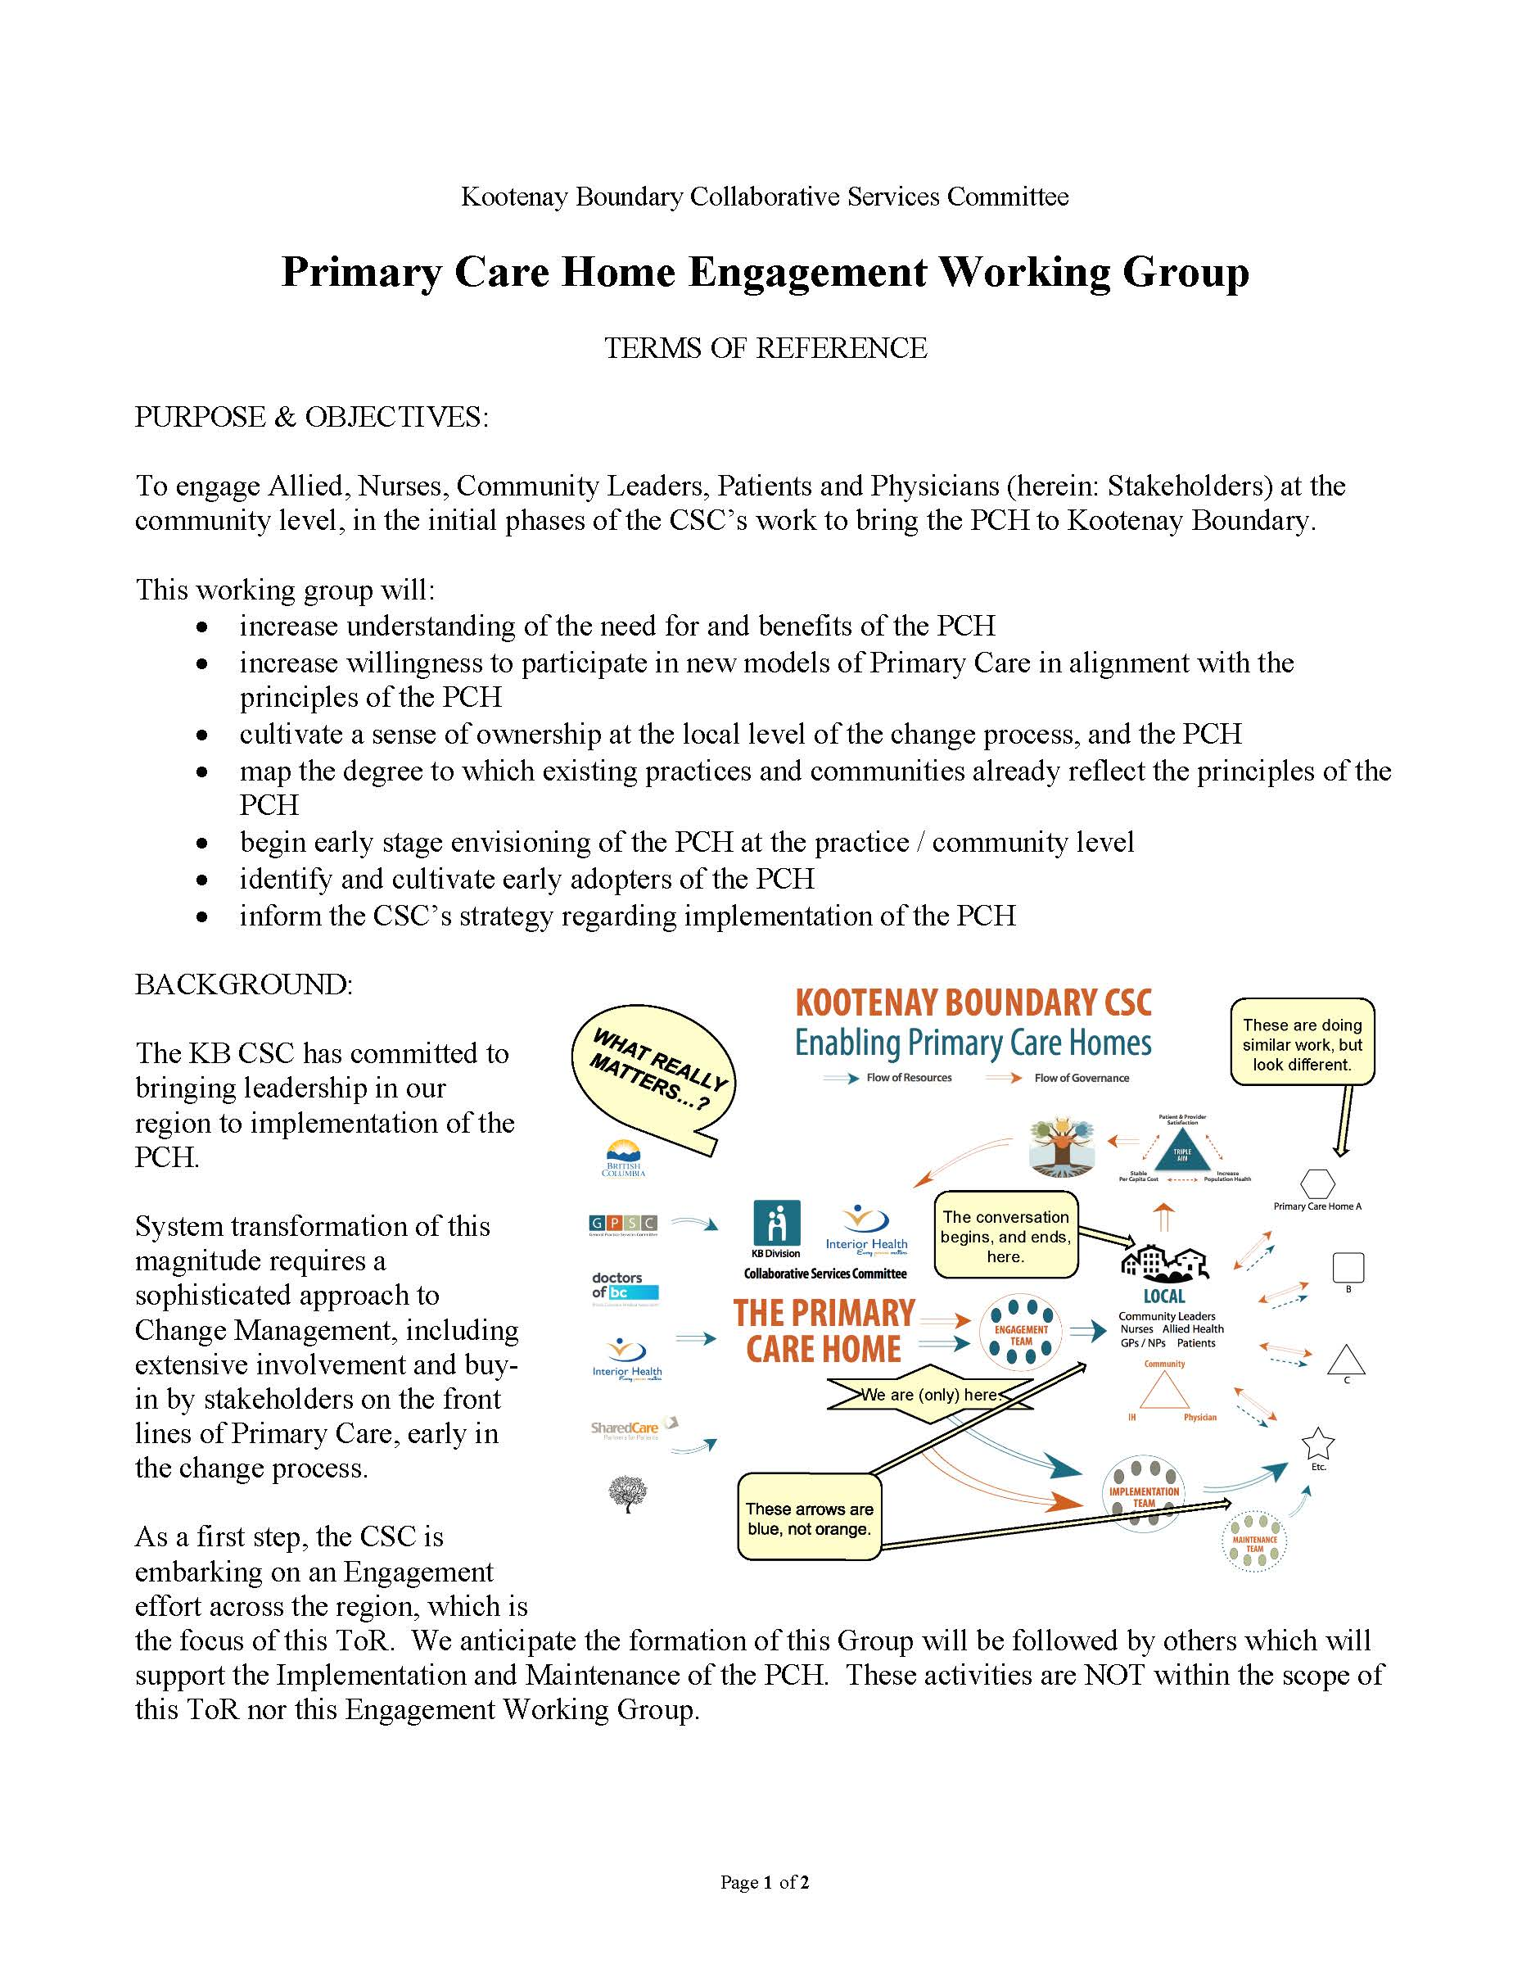
Notes:
The previous slides planning gave our CSC the confidence to delegate to a working group the responsibility to organize and host information engagements across Kootenay Boundary, targeting (separately this time) Doctors, IH staff, and Community Leaders.
This is the Terms of Reference for the Working Group, that outlines their task and reporting relationship back to the CSC.
The key message here is that if you can build enough trust at your CSC, you can delegate work to others, to get more done.

Slide 10
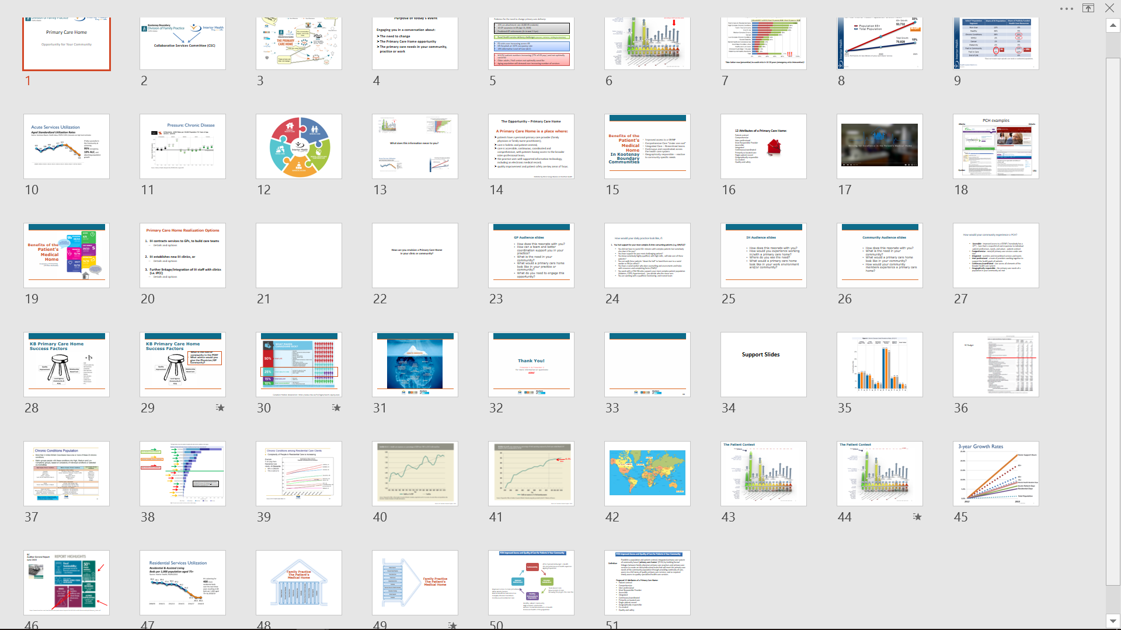
Notes:
And here’s an example of one of the customized presentations the Working Group put together.
Based on our Stakeholder Analysis at the February retreat, we prepared unique presentations for each Engagement event, be it Physicain, IH staff, or Community Leader.
…At the end of this presentation I’m happy to take questions on these slides from any of the audience at the back of the room. Please just refer to the row and column of the slide you’d like to know more about…

Slide 11
Notes:
Just kidding…
I’m going to go through a few key slides for you now, and highlight why they are important.
This one is the last in a series of a “build”… that positions the transformation as a locally driven exercise.
It ends with these yellow boxes and arrows:
Patient Medical Homes will do similar work, but be different, based on local needs
The conversation begins (the need for system improvement) and ends (design of Patient Medical Homes) at the Local
Resources (Blue Arrows) flow to communities, but Governance (Orange Arrows) flow from communities

Slide 12
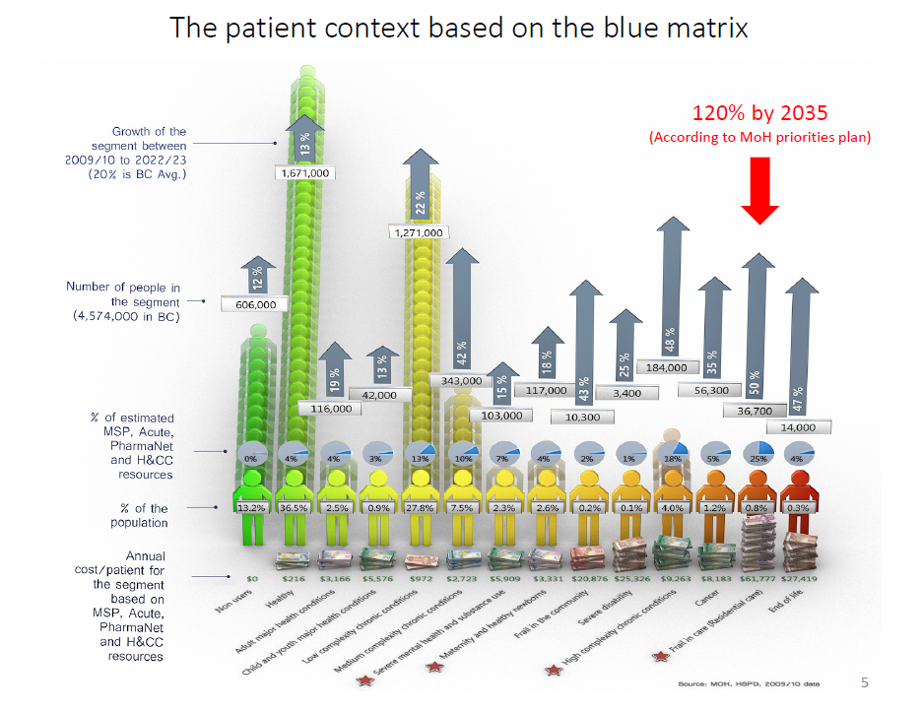
Notes:
This is Darcy Eyres infographic, combining data from the Blue Matrix (the Ministry’s database of system costs based on illness burden) and Growth in Population.
All of our audiences saw this graphic, and we spent quite a bit of time on it.
The key messages:
We are looking at this in a sophisticated way
We know a lot about costs
We are in big trouble, as the most expensive patients have the highest growth curves
As you look at this graphic, think back to what I said earlier about Change Management and “Building a Common Need”

Slide 13
41.5%
2016
Source: BC Auditor General report: 2015
Notes:
This one is also quite popular. It shows Health Care as a percentage of government revenues from 2000 to today. 29% to 41%.
Anybody in the room wondering why Education is the papers so much these days? Because Health Care is taking all the money.

Slide 14
PCH – Risks and Pitfalls for Community
Big Change, reduction in overall service… Managing the ongoing needs in Acute & ED & Complex MHSU
“The train not stopping” in your community… running on by
Downloading - Change in the Social Contract between Community and Citizens – Community now held accountable for Health?
ETC…
PCH – Risks and Pitfalls for Physicians
Team relationship / role clarification
Big Change, Small Improvement – negative R.O.I.
Physician Liability & responsibility in Team Based Care
ETC…
PCH – Risks and Pitfalls for IH Staff
Developing additional skills and expanded scope of practice
Recognizing need for change (they have gotten best outcomes to date -? Feelings of loss or lack of appreciation)
Requirement to change (again!) change fatigue within IH staff
ETC…
Notes:
We took lists like these, of the Risks and Pitfalls associated with change like this, and produced unique slides for every audience.
The point of showing you this is to consider the value of “leading” with these issues, rather than waiting for the nay-sayers in the audience to bring them up.
We put up list like this, and ask folks to add to them. They demonstrate that we understand and are managing the risks.
Leading with this info. allows the audience to get on with thinking about a newer, better future.

Slide 15
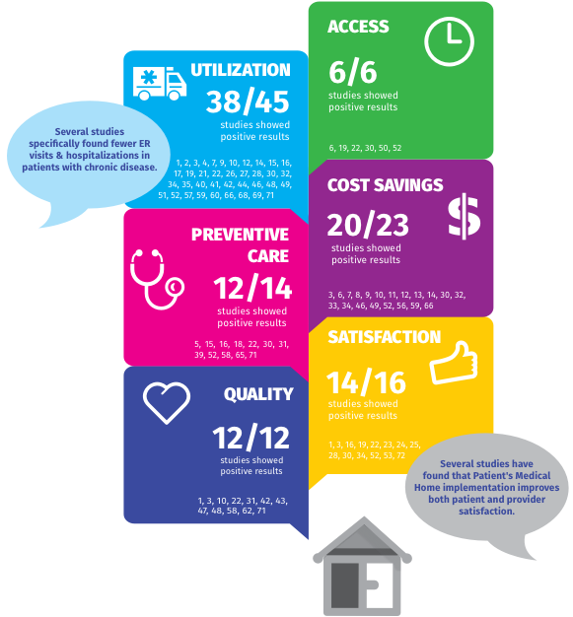
Benefits of the
Patient’s
Medical
Home
A summary of 73 Articles
(70 Peer Reviewed)
Notes:
And of course, we balance lists of the negative, with solid evidence of how the Patient Medical Home CAN, if properly implemented, produce results…

Slide 16
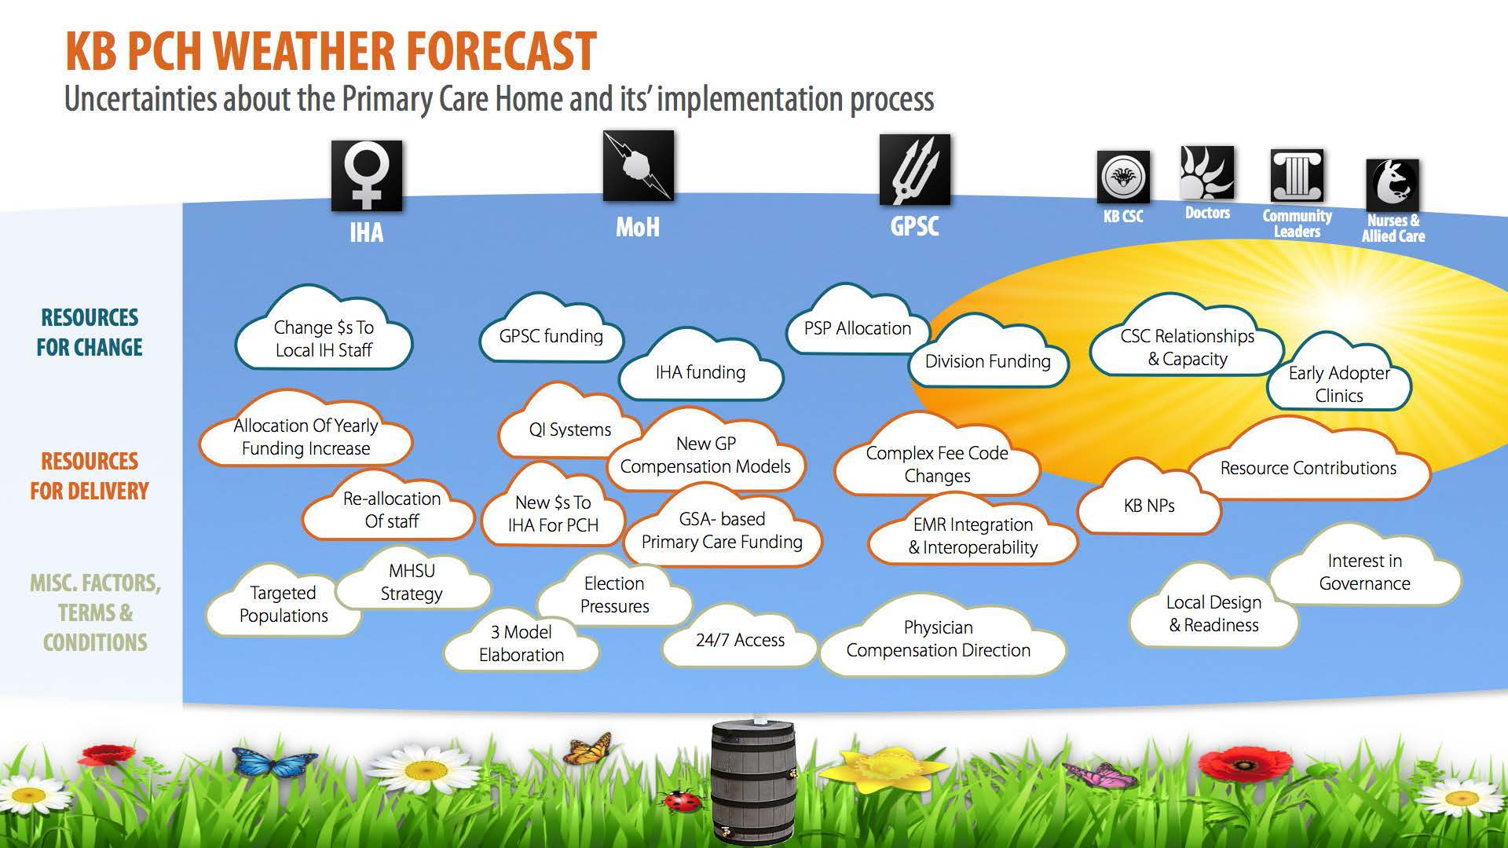
Notes:
And here’s the last slide I want to share with you about our Engagements with Stakeholders.
The title is “KB Primary Care Home Weather Forecast… Uncertainties about the Primary Care Home and its implementation process”
For those of you familiar with the classics, you’ll appreciate these symbols for the Greek Gods across the top. The Weather makers, if you will – IHA, MoH and GPSC…
The point of this slide is to manage expectations in a complex system that nobody can really control.
There are many players. They don’t all get along. They don’t know what to do. An action by one of them can throw the other totally off track.
And we all know there’s way more weather makers then even this graphic shows. (think: Unions, for example…)
But notwithstanding all that uncertainty, it’s clear there’s going to be weather. It’s going to rain.
Our job is to build the barrel, and water the garden.

Slide 17
Outcomes of the Work:
Broad Physician interest across KB
Clinic re-organization conversations in three communities
Focused and cohesive CSC
Strong Community Leader interest
Proof of Concept “status” at GPSC
Proof of Concept funding by IHA:
$500K for new nursing & allied
Notes:
So where has all this work gotten us?
[Read Slide...]
As I may have mentioned, this last funding is pretty new news for us. IH’s CEO Chris Mazurkewich announced it at our AGM last Thursday.
I’ll wrap up now with just a few themes about this funding…

Slide 18
Concept: High Skill Rural Generalism
In rural communities, where economies of scale for specialised services are absent, highly skilled and highly integrated generalist teams are the most effective approach to affect the core system challenges...
Notes:
First, What we plan to do…
[Read Slide]
I trust a few of you in the room will resonate with this statement…

Slide 19
Process…
The CSC will facilitate a collaborative, consensus-based planning process with Boundary GPs & IH staff, CSC leaders, and (if desired) IHA senior representatives, to reach agreement by all parties re.:
Outcome Targets
Framework for QI & Team Development processes
Incremental Staffing Complement
Governance of New Staffing
Notes:
Second, our next steps. This is a pretty important slide.
We actually got the Health Authority to commit these funds with very little detail about what we are going to do with them.
What the slide demonstrates is “the catch”… that we won’t spend a penny until a consensus decision, of all key stakeholders, including Doctors in the Boundary, is reached. AND… that this decision will be respected by those not at the table.
This, for us, is what CSC and Division work is all about. Local people are respected and given real power in design decisions. But nobody gets to call the shots. Consensus has to be achieved.

Slide 20
(DRAFT!) Outcomes
Decrease the CTAS 4 & 5 ED visits by 30% over 12 months and 50% over 3 years
Reduction of MHSU clients and service days to KB levels of 48/1000 pop and 576 service days/1000 pop over 12 months and further reduction to IH levels (32/1000 and 376/1000, resp.) by year 3
Decreased hospitalization for 75+ patients of 20% over 12 months, and a further reduction of 20% by year 3.
Etc…
Notes:
And finally, I couldn’t end a description of this Proof of Concept without showing the kinds of Outcomes we are expecting to achieve.
And while its’ true that these are draft, and the Process I described on the previous slide still needs to happen before we commit to them, I think its fair to say that the CEO of the Health Authority probably wouldn’t have placed his trust in us in this way, without this kind of detail about real, consequential system savings.

Slide 21
Summary:
Embrace the opportunity for something bigger.
Apply rigorous change and engagement theory.
Be political, strategic and maximize relationships. Local & Provincial.
Think complex system:
  Nobody is in charge.
  Demand local governance.
  Assuage insecurity with story.
Utilize experienced Physician voice.
Focus on the BIG problems.
Lead with risks and pitfalls. So others don’t.
Sing the “single aim”, Per Capita Cost
Notes:
I’ll finish today with a summary of some of the themes I’ve shared today.
I won’t read them to you, but I will end with a sincere offer to share any of our work with you directly.
We are happy to talk about this with anyone, share our materials and presentations, etc…
Please contact us at any time, and we look forward to the discussion later.

