Slide 1
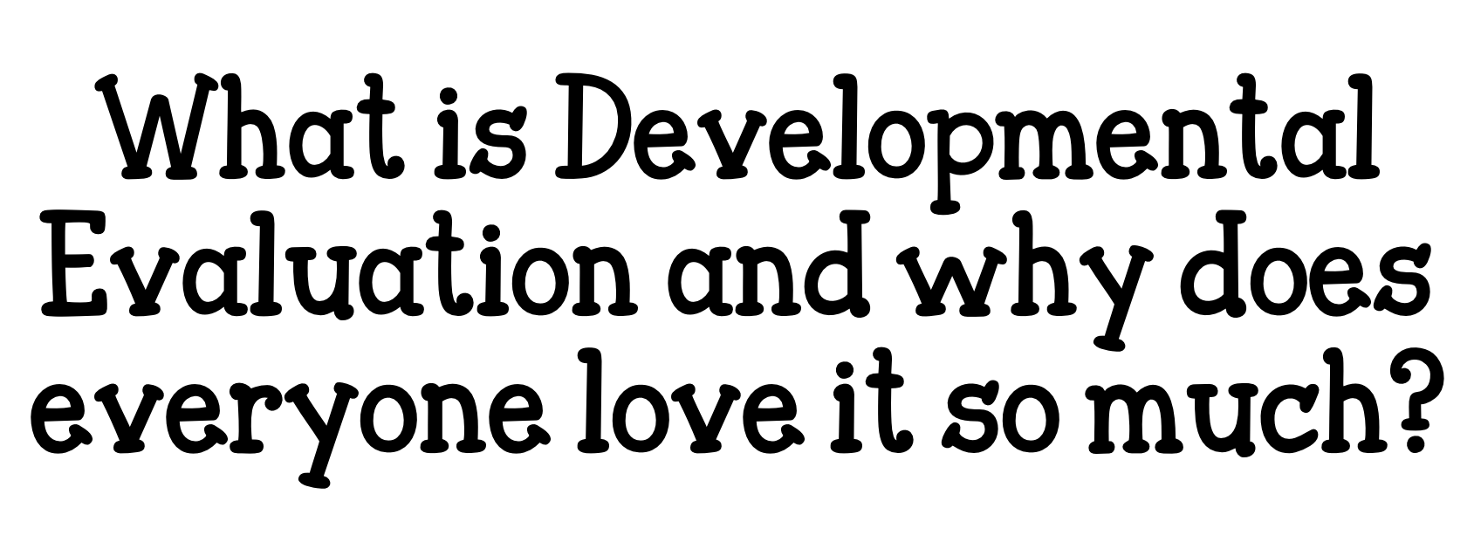

Slide 4
Notes:
take a piece of blank paper, split it down the middle
think about the summer you have ahead of you, and now imagine it’s Tuesday, Sept. 5th and you’re back at work
on the right hand side, write down what will be different on that day, as a result of your summer, i.e. what are your anticipated summer outcomes?
e.g. more relaxed, more healthy, tanned, buff body, new skills, new places visited, stronger family ties
now on the left-hand side, write down what you think needs to happen for these outcomes to happen (activities)
now if I ask you to tell me how confident you are that all of these activities on the left side will occur exactly as you planned, what would say?

Slide 5
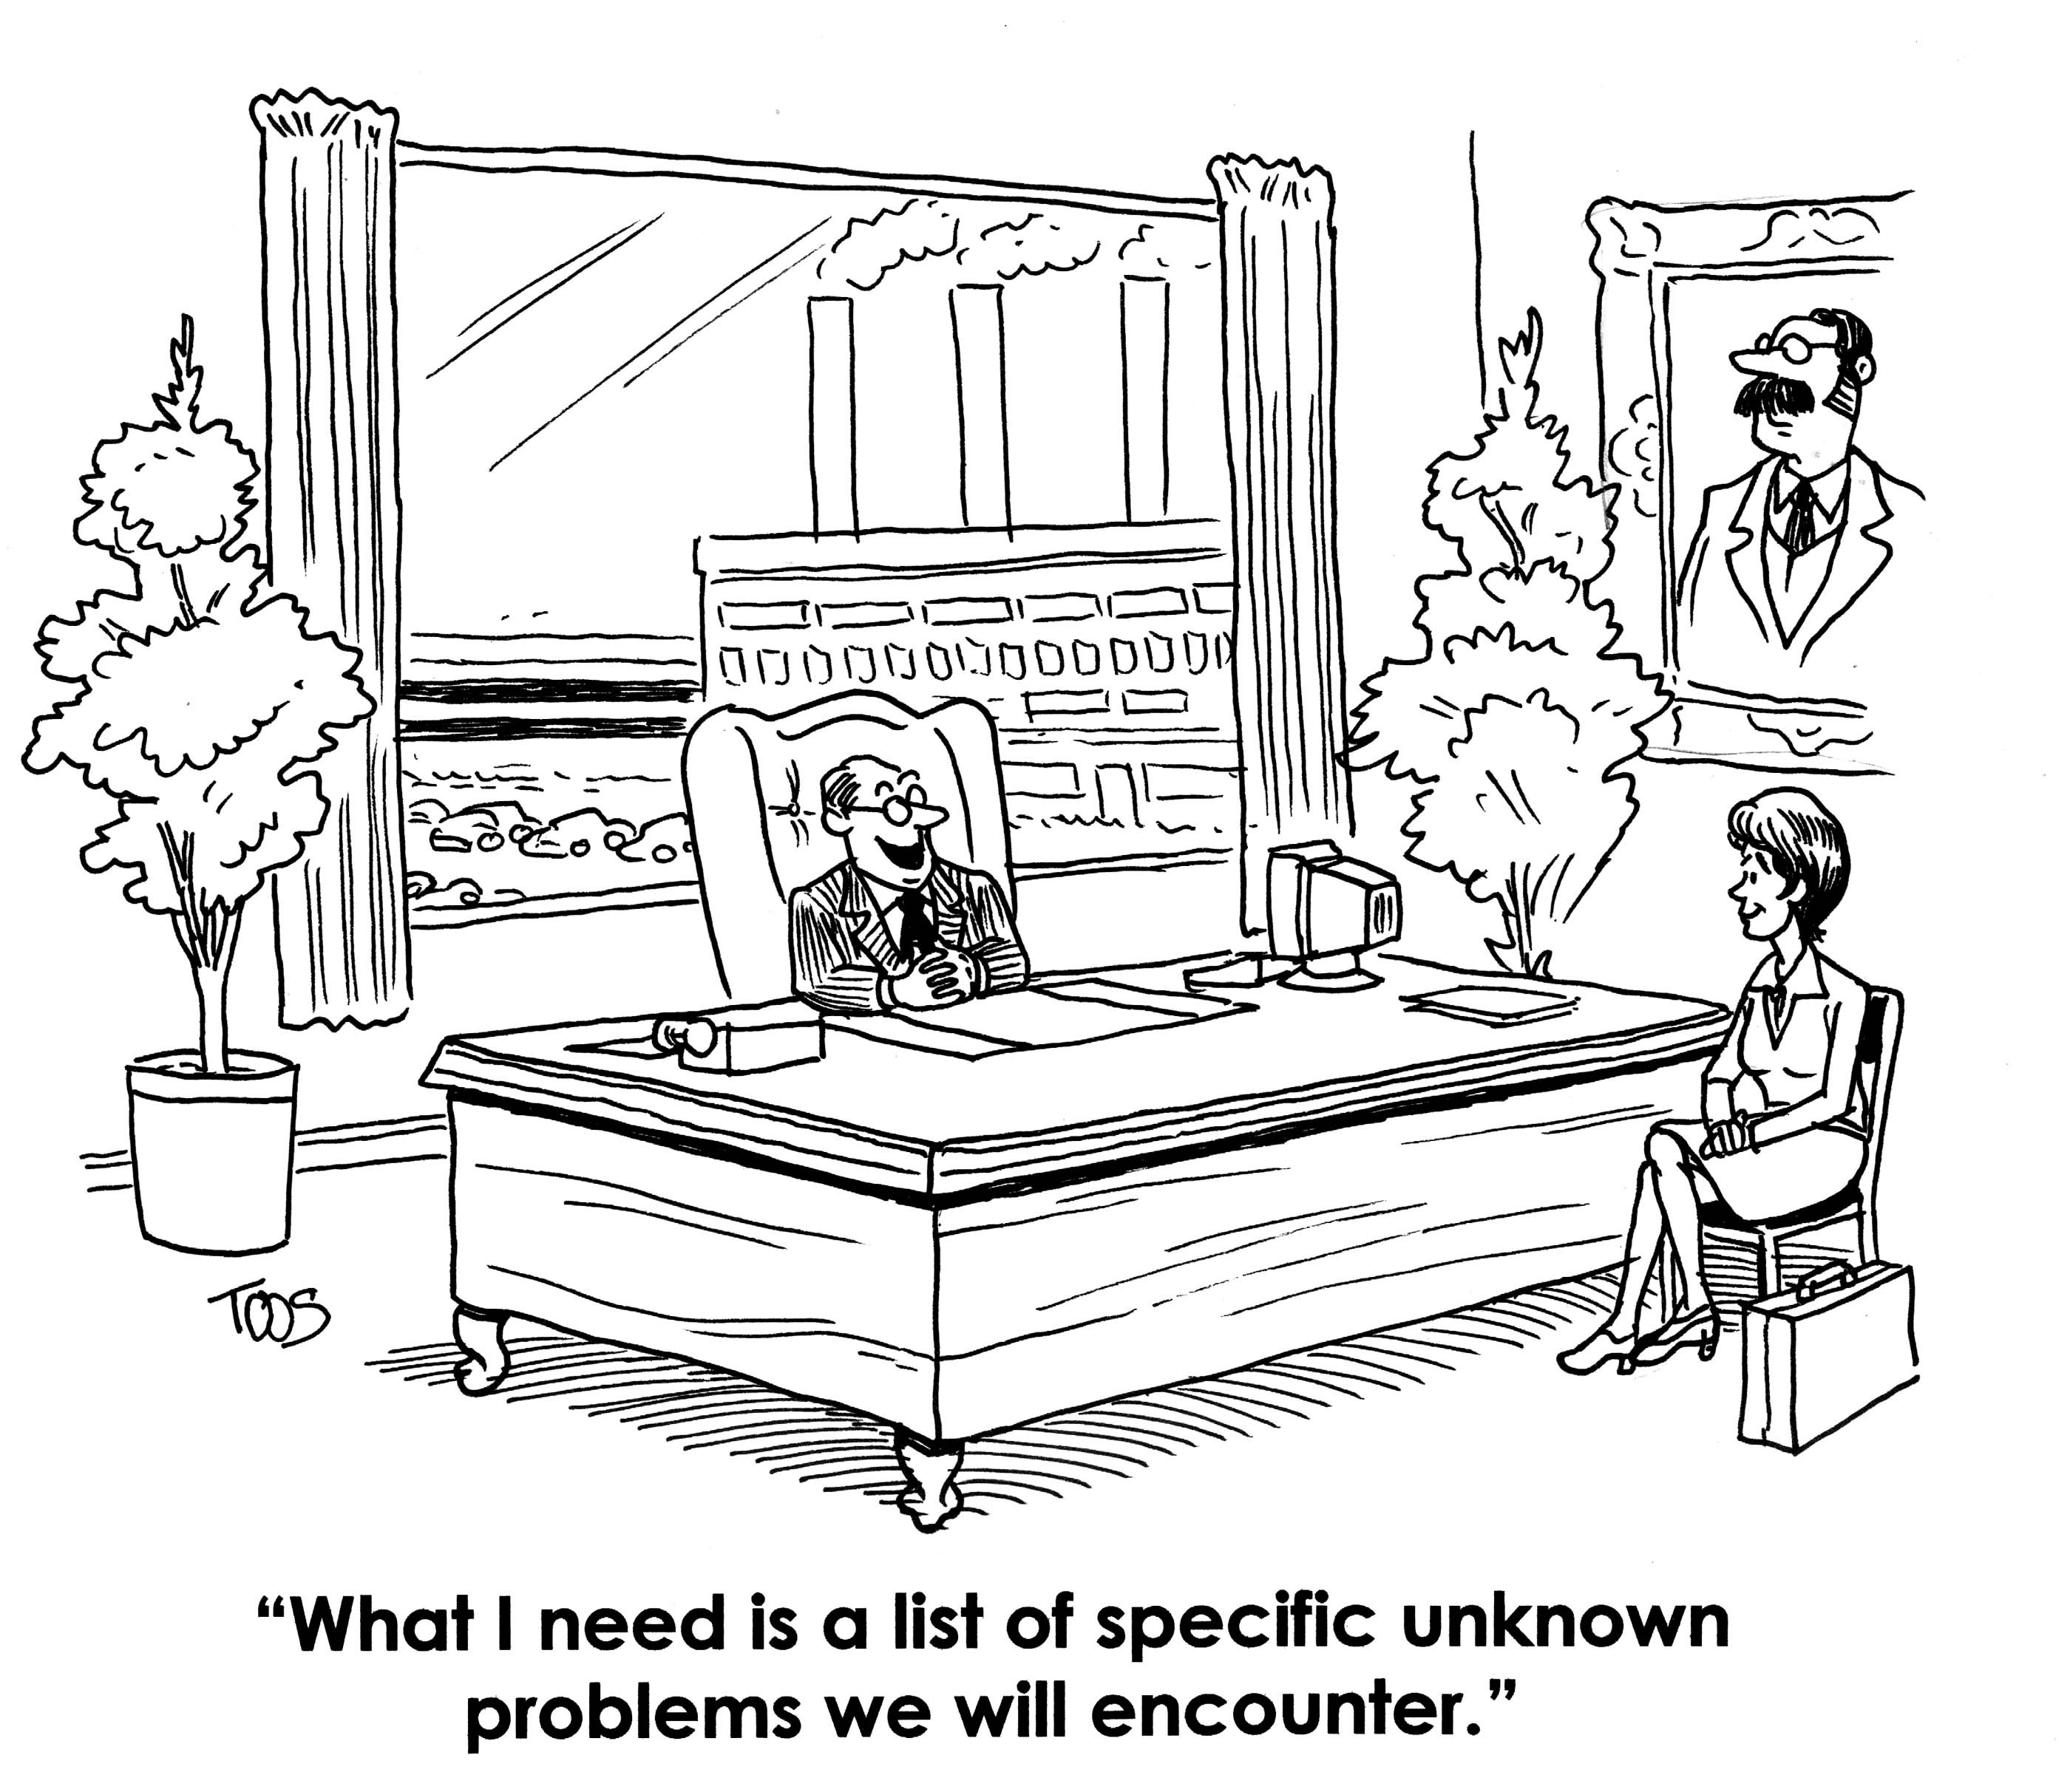
Notes:
It’s the same with our projects
sometimes we’re clear on our long-term outcomes, but don't always know exactly how we’re going to get there
sometimes they don’t always roll out exactly as we intended or stated in the proposal
or sometimes we need to make a course correction half-way through

Slide 6
Notes:
This is the reality, particularly with something like PMH
By defintion PMH is a health care innovation, but none of us has a crystal clear idea of how it’s going to roll out, nobody knows, particularly the physicians who have to implement it on the ground

Slide 7
Notes:
What is actually realized over time usually looks very different than what we expected
The key is being open to seeing and evaluating those emergent outcomes, because they’re important for aiding innovation

Slide 8
Notes:
Tell story of how developmental eval came about (MQP’s project in Minneapolis)
DE is designed for evaluating highly complex situations that unfold in a dynamic and unpredictable way

Slide 9
Notes:
developmental eval is a flexible form of eval that permits rapid, real-time feedback, learning, and course corrections

Slide 10
Notes:
Whenever I think of DE, this is image that always comes to mind for me
DE provides info that helps you decide at each fork in the road, What should we do next?
Physicians need timely, real-time info on what’s working or not, DE is nimble enough to do that

Slide 11
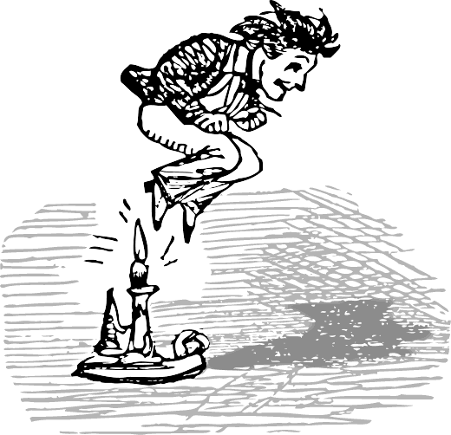
Notes:
DE is a very nimble form of eval
I’m going to describe some of the typical features and elements of DE

Slide 12
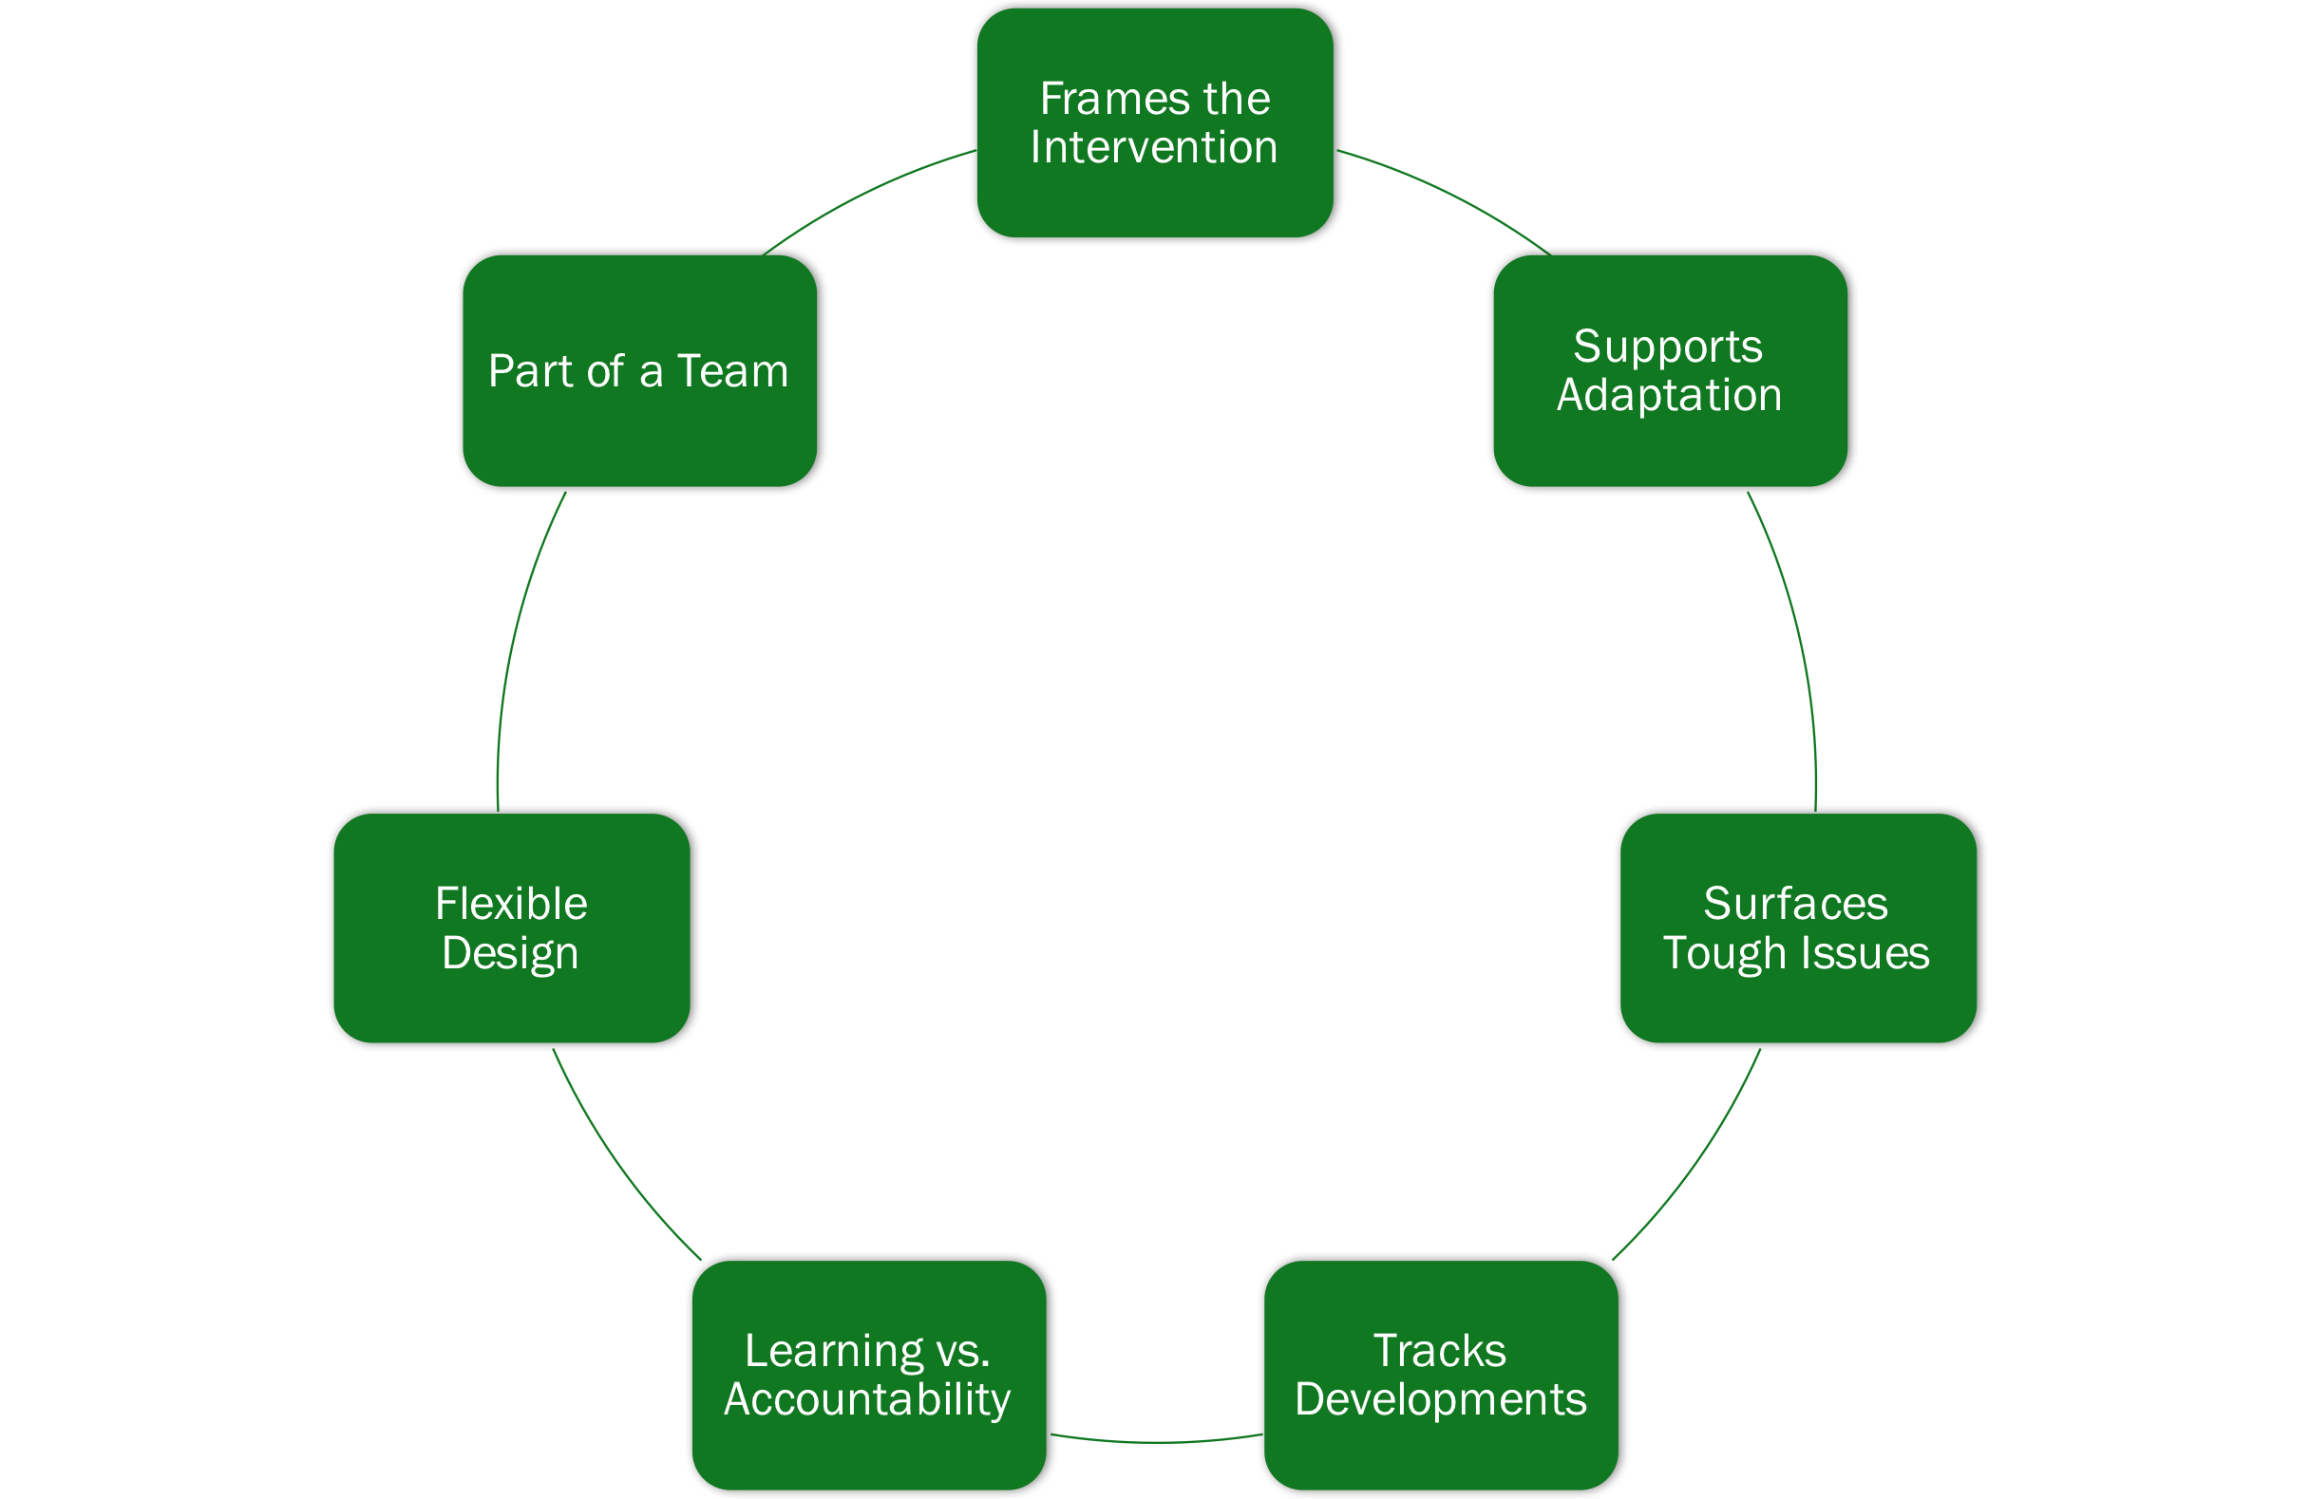
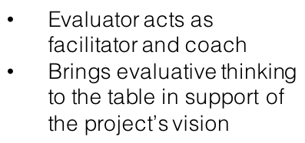
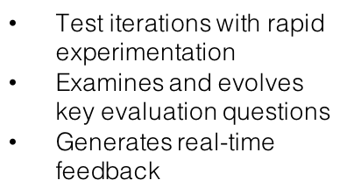
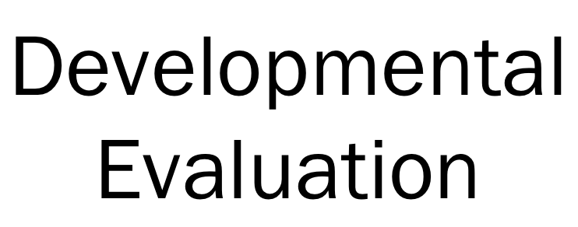
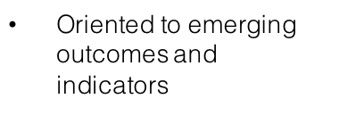
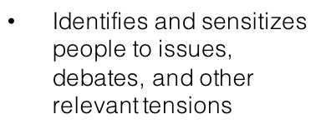
Notes:
Address each

Slide 13
Notes:
Go through each relating to my DE work with PRRSC, others (Vancity), and PMH (particularly how it can help physicians implementing DE on the ground)
and measurement can also be clearly linked to and inform organizational strategic direction and planning by providing timely meaningful data for organizational-level improvement, learning and innovation – PG’s example will illustrate how this could be used

Slide 14
Notes:
example: my dev eval experience with Provincial Recruitment & Retention Steering Committee
wrote eval plan in Oct 2015, did the best I could with what we knew at the time
committee knew what it wanted to achieve, but had only a rough idea of how it was going to accomplish this, quite rightly
[give examples of how I’ve applied developmental eval over time]
UBC FoM data
shared marketing eval
College example

Slide 15
Notes:
MQP said this once, but not sure if it’s his quote or not
developmental eval appropriate for complex situations with high uncertainty and unpredictability, just like PMH

Slide 18
Notes:
example of how a division-level evaluation can be aligned with a provincial-level one

Slide 19
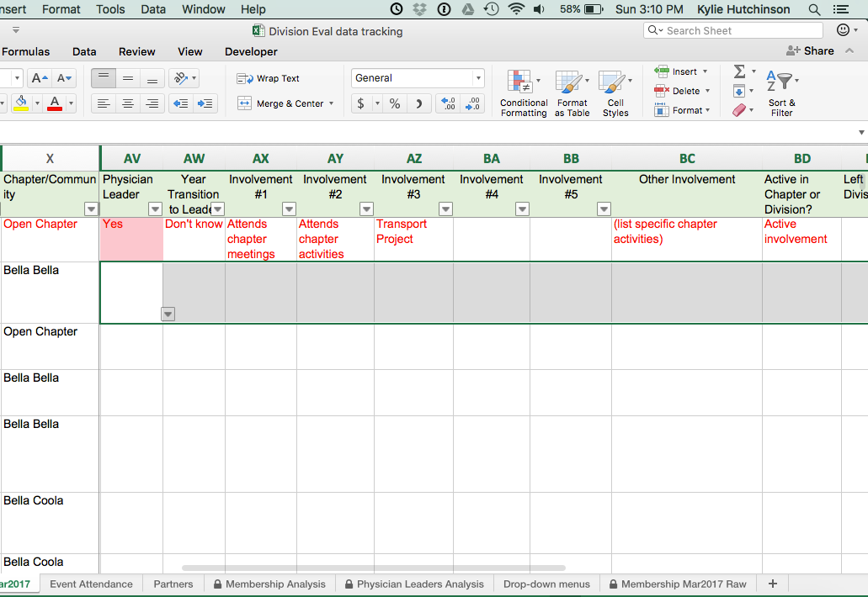
Notes:
at Rural and Remote I was tasked with conducting a small evaluation of the division itself
I knew about the IMF framework, but all that was available at the time was the visual, no actual data collection tools
I too wanted to look at member engagement and physician leaders, so I created this spreadsheet for the division’s chapter coordinators to complete for each member
as I was passing it around for comment, one of the chapter coordinators said, “Hey, this looks like the division’s IMF survey.

Slide 20
Notes:
and so it did

Slide 21
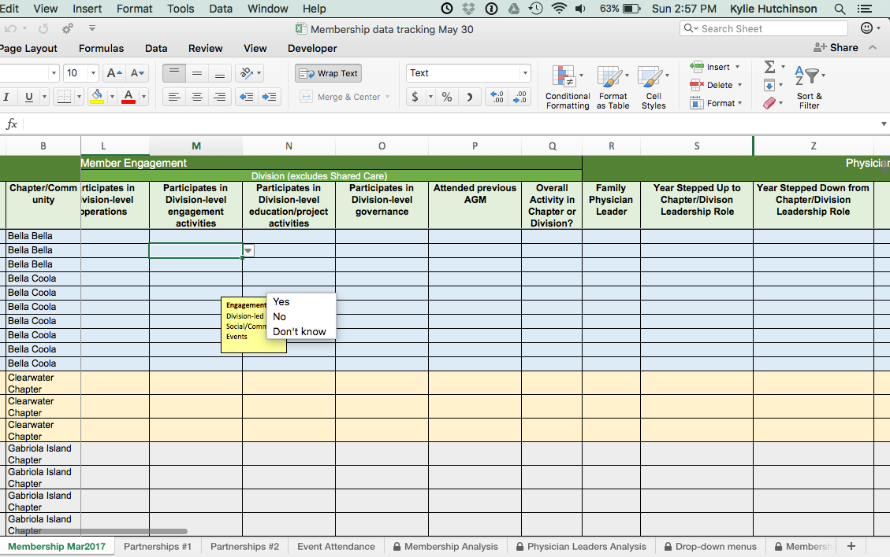
Notes:
so I re-vamped the questions so they would collect chapter level data that could be rolled up across the division and used to complete the broader IMF survey too
also revamped some interview and focus group questions to ensure they would provide data that would inform other questions on the IMF survey as well

Slide 22
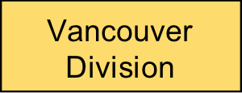
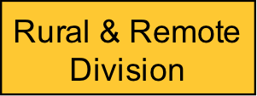
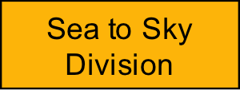
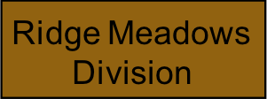
Single division
Province-wide
Notes:
here’s another example of how alignment works
questions?

