Slide 1
British Columbia Primary Health Care Research Network
A Vehicle for Innovation and Transformation
Sabrina Wong, Fiona Duncan, Shana Ooms, Annette Garm
April 2018

Slide 2
Disclosure
Presenters: Sabrina Wong, Fiona Duncan, Shana Ooms, Annette Garm
Relationships with commercial interests:
  Grants/Research Support: BC PHCRN, TRANSFORMATION, and FRAILTY are supported by the Canadian Institutes for Health Research and the Michael Smith Foundation for Health Research
  Speakers Bureau/Honoraria: None
  Consulting Fees: None
  Other: None

Slide 3
Managing Potential Bias
• Material presented is unrelated to financial relationship with CIHR or MSFHR
• Wong, Duncan, Ooms provide scientific, clinical and policy leadership to BC PHCRN
-BC PHCRN has an advisory committee made up of various stakeholders and a patient advisory committee

Slide 4
BC PHCRN Session
Overview: Fiona and Shana
BC PHCRN data platform: Sabrina
Examples
  Frailty: Annette
  QI tools, CWL, TRANSFORMATION: Sabrina
Response: Fiona and Shana

Slide 5
  Provincial/Territorial Tripartite Leadership of PIHCI Networks / Leadership Council:
    Researcher
    Policy/Decision Maker
    Clinician
    Patients
Network Leadership Council and National Coordination
NWT Network
AB Network
Newfoundland and Labrador Network
SK Network
BC Network
MB Network
QC Network
NB Network
NS Network
ON Network
PEI Network

Slide 6
Purpose
Overall Purpose: To support evidence-informed transformation where the primary care home/patient centered health home plays a central part of the delivery, coordination, and integration of health care delivery
Become a member: Visit our website and click on the “Participate” tab, or email us at info@spor-bcphcrn.ca

Slide 7
BC-PHCRN – Tripartite Leadership
Science Lead
  Dr. Sabrina Wong, Director of the Centre for Health Services and Policy Research and Professor, UBC
Clinical Co-Leads
  Dr. Fiona Duncan, Associate Professor of Clinical Practice, UBC
  Dr. Anne Junker, Investigator, BC Children’s Hospital
Policy Co-Leads
  Heather Davidson, ADM, Planning and Innovation Division for BC Ministry of Health
  Shana Ooms, Executive Director of Primary Care in the Primary and Community Care Policy Division at the BC Ministry of Health

Slide 8














BC-PHCRN - Advisory Committee
Physicians Data Collaborative
Vancouver Citizens Health Initiative

Slide 9
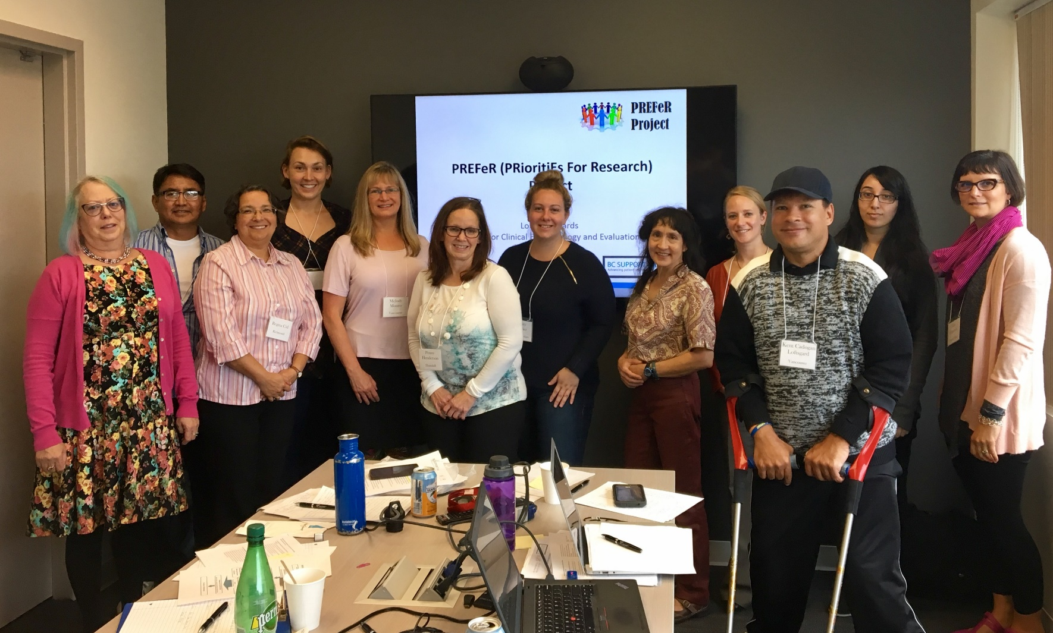
BC-PHCRN Patient Advisory

Slide 10
Engaging clinicians through Divisions of Family Practice
Participate in and support projects meant to increase continuity of care:
  Relationship between clinician and patient panel (frailty, QI tools for EMR)
  Information and management continuity between primary care and health authorities (CWL, IHA-KB project)
Participate in and support projects meant to increase quality of care:
  Regional performance measurement; practice based reports using patient medical home framework (TRANSFORMATION)

Slide 11
BC-PHCRN Exemplars of Supported Projects
Project Title | Leads | Divisions Engaged
Validation of Administrative and Primary Care Electronic Medical Record Derived Frailty Algorithms | Annette Garm/Grace Park, Fraser Health Authority and Sabrina Wong, University of British Columbia and | Whiterock, South Surrey
Implementation of InQUIRE and Data Presentation Tools with Electronic Medical Records | Sabrina Wong, University of British Columbia | Various clinicians across BC, Kootenay-Boundary Division
A Comparative Analysis of Centralized Waiting Lists for Unattached Patients Implemented in Five Canadian Provinces | Mylaine Breton, Université de Sherbrooke | Chilliwack, Whiterock
Implementing a health information system for program planning across Interior Health | Douglas Kingsford, Interior Health Authority and Kootenay-Boundary Division | Kootenay-Boundary Division
Improving the Science and Reporting of the Primary Care Patient Medical Home (TRANSFORMATION) | Sabrina Wong, Fred Burge (MD-Dalhousie), Sharon Johnston (MD-U of Ottawa) | Chilliwack, Abbotsford, Hope/Mission

Slide 12
BC-PHCRN Supported Projects
Project Title | Nominated Principal Applicant | BC Team
Building Wellness and Resilience in Multi- Generational Indigenous Households: A Scoping Review | Cheryl Currie, University of Lethbridge | Anne Marshall, University of Victoria
Dimensions of Quality for Mobile Applications in Chronic Disease Management: A Review of Systematic Reviews | Jay Shaw, Women’s College Hospital | Elizabeth Borycki, University of Victoria Andre Kushniruk, University of Victoria Scott Hofer, University of Victoria
Integrating Paramedics into Primary Care to Optimize Patient Time in the Community at End of Life | Alexandra Carter, Nova Scotia Health Authority | Sabrina Wong, UBC Jennifer Kryworuchko, UBC Kimberlyn McGrail, UBC
Policies and Program Innovations that Connect Primary Health Care, Social Services, Public Health and Community Supports in Canada: A Comparative Policy Analysis | Jeannie Haggerty, McGill University | Jason Sutherland, UBC Leanne Currie, UBC Nelly Oelke, UBCO Dr. Anne Junker, Clinician Victoria Schuckel, Ministry of Health
What are the Impacts of Being Formally Enrolled with a GP on Continuity and Integration of Care? Evidence from a Comparison of Quebec and British Columbia | Erin Strumpf, McGill University | Kimberlyn McGrail, UBC Miriam R Lavergne, SFU Heather Davidson, Ministry of Health

Slide 13

BC PHCRN EMR data platform: Canadian Primary Care Sentinel Surveillance Network

Slide 14

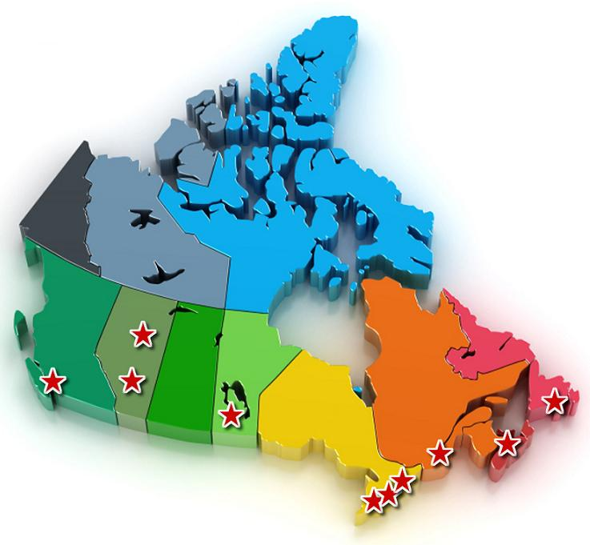
Unique pan- Canadian primary care database
The Canadian Primary Care Sentinel Surveillance Network:
1.6 million Canadian patients
1248 practices
12 PBRNs in 8 provinces, 1 territory
Some EMR data back to 2003
Started in 2008
$12.5M funding from PHAC
Strong partnerships with College of Family
Physicians of Canada, Queen’s and other Universities
B.C. (BCPCReN), Alberta (SAPCReN, NAPCReN), NWT, Manitoba (MaPCReN), Ontario (DELPHI, UTOPIAN, EON, MUSIC), Quebec (RRSPUM), Nova Scotia/New Brunswick (MaRNet), Newfoundland (APBRN)

Slide 15
CPCSSN Primary Care Research Networks
British Columbia
BCPCReN, Vancouver
Alberta
SAPCReN, Calgary
AFPRN, Edmonton
Manitoba
MaPCReN, Winnipeg
Ontario
DELPHI, London
UTOPIAN, Toronto
EON, Kingston
McMaster, Hamilton
U of O, Ottawa
Quebec
RRSPUM-Réseau de recherche en soins
primaires de l'Université de Montréal
Nova Scotia/New Brunswick
MaRNet, Halifax
Newfoundland
APBRN, St. John’s
12 PBRNs in 8 provinces using 17 EMRs across Canada

Slide 16












CPCSSN Partner Universities

Slide 17
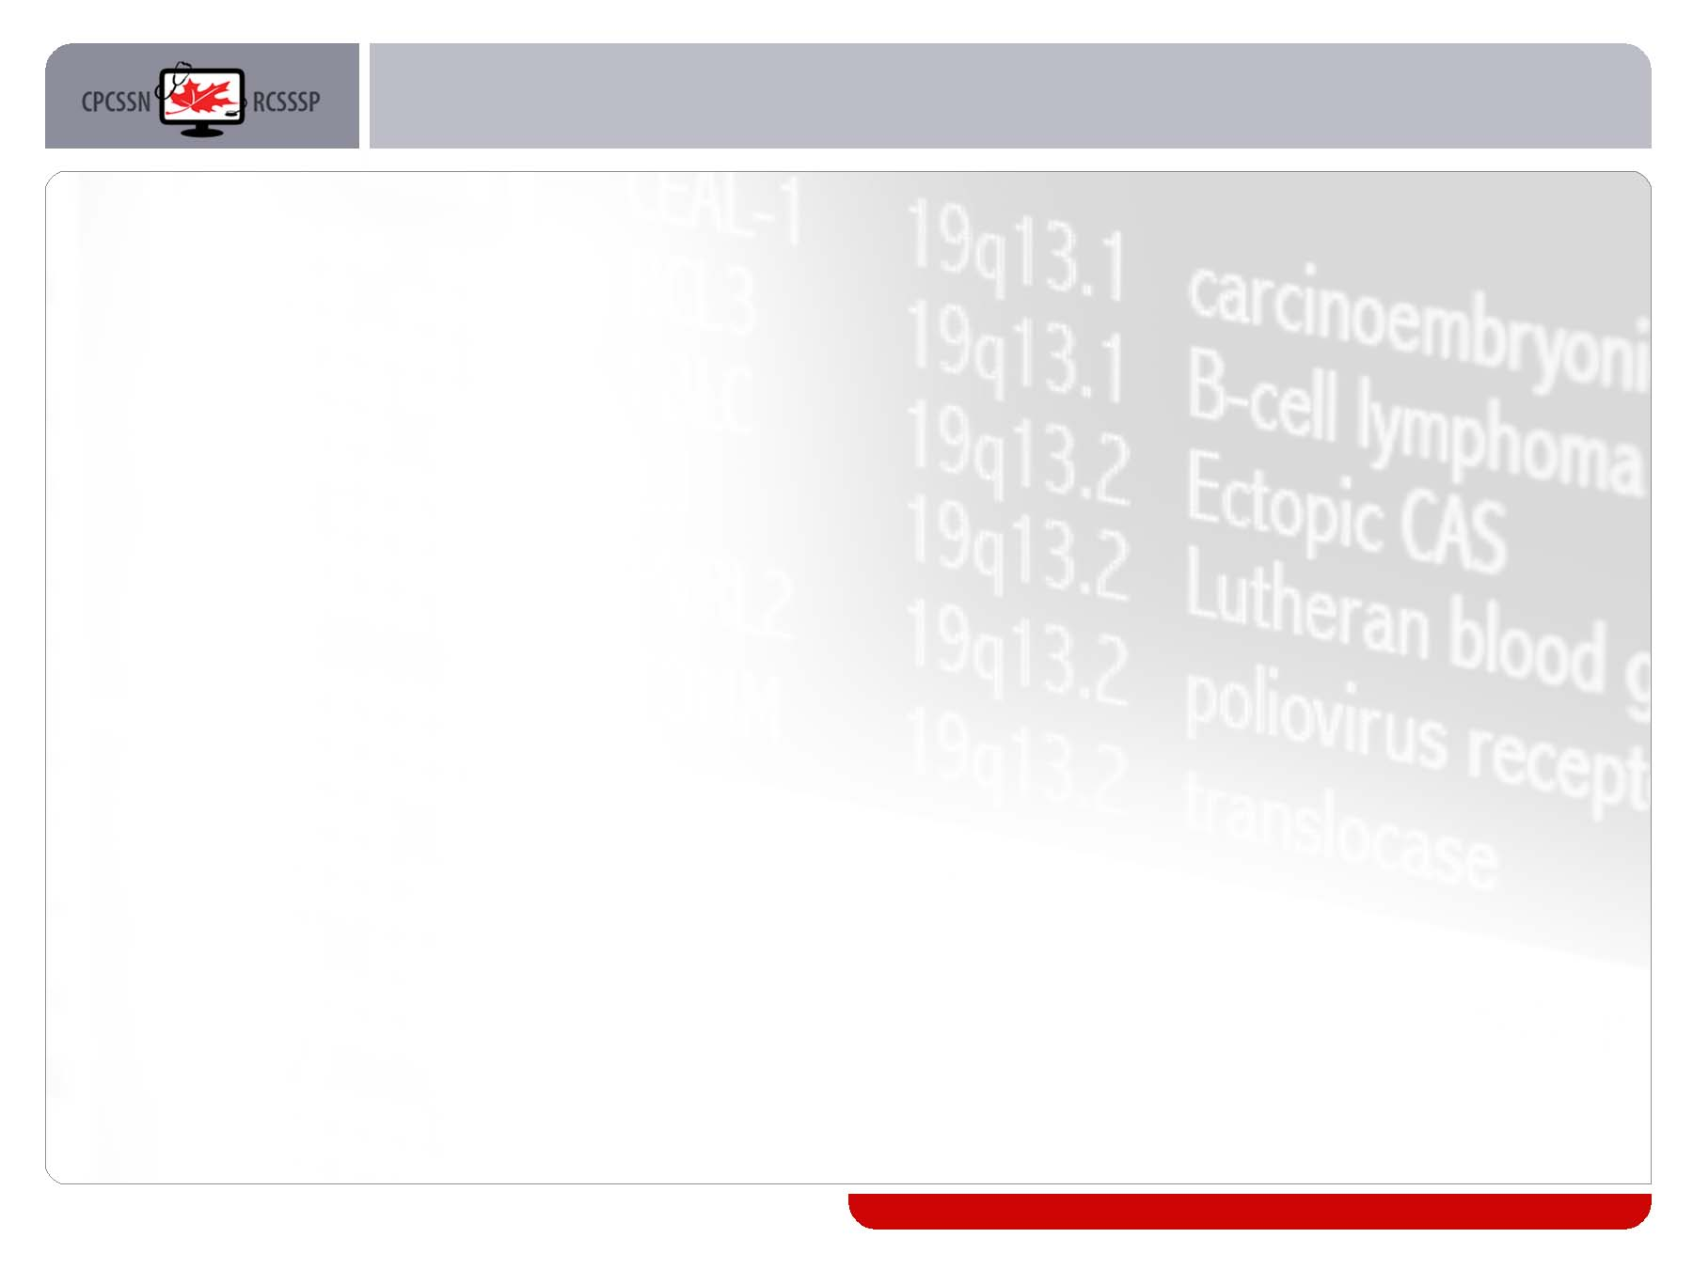
17 EMRs supported
Vendor | Product | In Provinces
Telus | PS Suite | AB, ON
Telus | Wolf | BC, AB, NL, NT
Telus | Med Access | BC, AB
Telus | Nightingale | ON, NS, NL
Telus | Medesync | QC
Intrahealth | Intrahealth | BC
QHR | Accuro | MB, ON
QHR | Healthscreen | ON
(open source product VARs) | OSCAR | BC, ON
Telin | Telin | AB
Healthquest | Healthquest | AB
Purkinje | Dossier | QC
P&P Data Systems | CIS EMR | ON
Purkinje | Dossier | QC
Bell Canada | Xwave | ON
Da Vinci | Da Vinci | QC
Jonoke | JonokeMed | MB

Slide 18
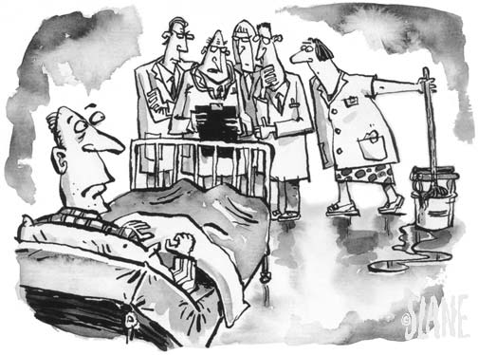

Privacy and Ethics
Opt-out consent
12 Research Ethics Board approvals
Stored in a highly secure facility
Data are de-identified

Slide 19

CPCSSN – Data
Provider profile
Patient socio-demographics
Disease/ health condition
Encounter data
Risk factor data
Examination data
Medications
Laboratory data
Referral data
Procedure data

Slide 20

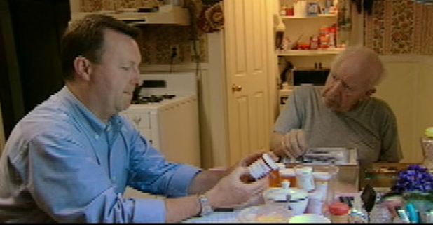
Patients in database:
Chronic Obstructive Lung Disease 29,146
Depression 108,775
Diabetes 67,651
Hypertension 148,300
Osteoarthritis 77,235
Dementia 18,199
Epilepsy 8,477
Parkinson’s Disease 2,675

Slide 21

Using the CPCSSN Platform: Fraser Health Authority CARES project

Slide 22
Community Actions and Resources Empowering Seniors: Frailty Assessment in Primary Care
Annette Garm, RN/Grace Park, MD
Family Physician, Park McDonald Inc.
WR/SS Division of Family Practice, PAH
Fraser Health Home Health Regional Medical Director

Slide 23
Proactively Delaying Frailty in At-risk Seniors
CARES: Community Actions & Resources Empowering Seniors)
Is a targeted initiative which partners primary care physicians with at-risk seniors and health coaches for 3-6 months to prevent frailty and frailty-related health care use
Uses the Comprehensive Geriatric Assessment (CGA) and the Frailty Index (FI) as a measure of the senior’s progress toward or away from frailty
Embeds CGA-FI into the physician’s EMR for point of service calculation of the FI
Notes:
CARES partnerships include:
Divisions of Family Practice
University of Dalhousie
Nova Scotia Health Authority
University of Victoria’s Institute on Aging and Lifelong Health
Canadian Foundation for Health Care Improvement

Slide 24
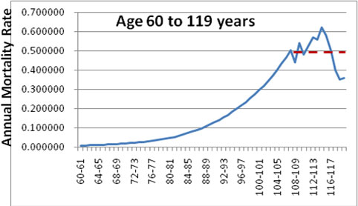

Frailty – the noun: unmeasured heterogeneity
Vaupel J, Manton K, Stollard E. The impact of heterogeneity in individual frailty on the dynamics of mortality. Demography 1979; 16:439-54

Slide 25
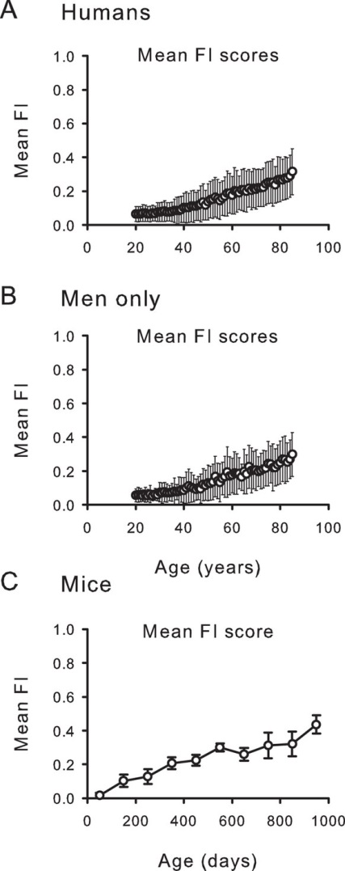
Combined in a frailty index, the variable patterns of deficit accumulation show a steady increase with age
Rockwood et al., Sci Rep 2017 Feb 21;7:43068

Slide 26
Geriatric Giants
immobility
instability
incontinence
impaired intellect/memory
impaired independence
Isaacs B. The Challenge of Geriatric Medicine. OUP 1980
“sensitive but non-specific signs of illness in older adults”

Slide 27
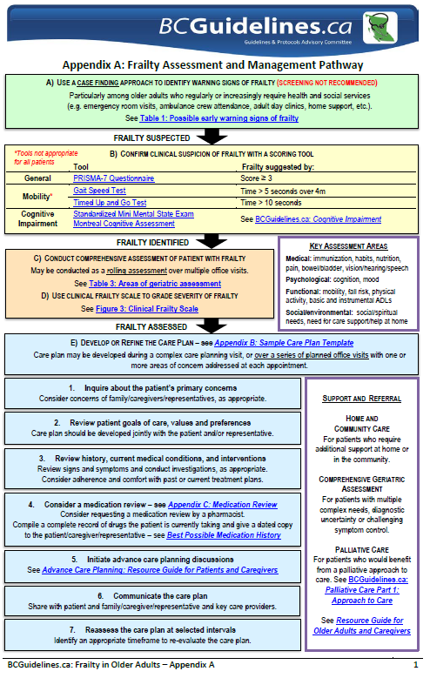




Slide 28
CGA & Care Planning
The purpose of the CGA is the care plan. The initial contact captured in the CGA needs to be verified and updated to serve as an accurate baseline.
It needs to be completed with the best available information, not simply a record of “what the client says”.

Slide 29
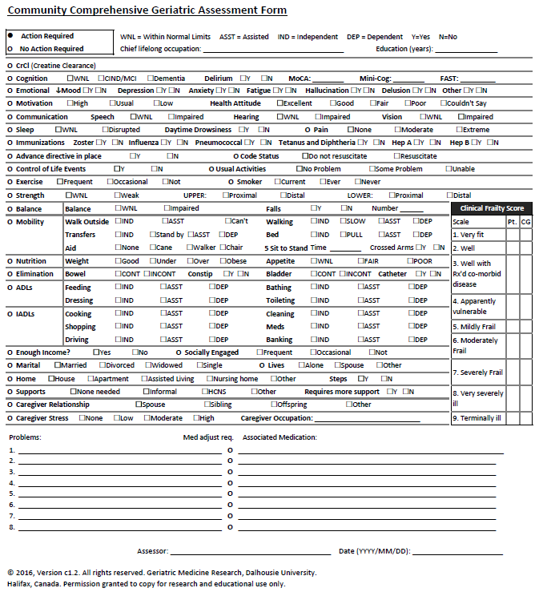
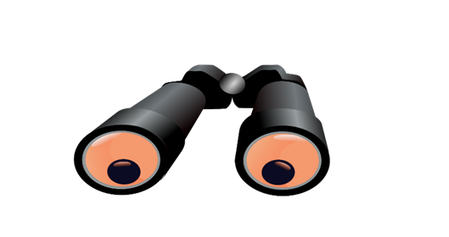
BC PHCRN: Using the CGA (and other data) in Practice
CPCSSN: Translate
these data
Into visual format to
view in QI tools

Slide 30
Engaging clinicians through Divisions of Family Practice
Participate in and support projects meant to increase continuity of care:
  Relationship between clinician and patient panel (frailty, QI tools for EMR)

Slide 31

Practical Uses of the Data
Practice Quality Improvement

Slide 32
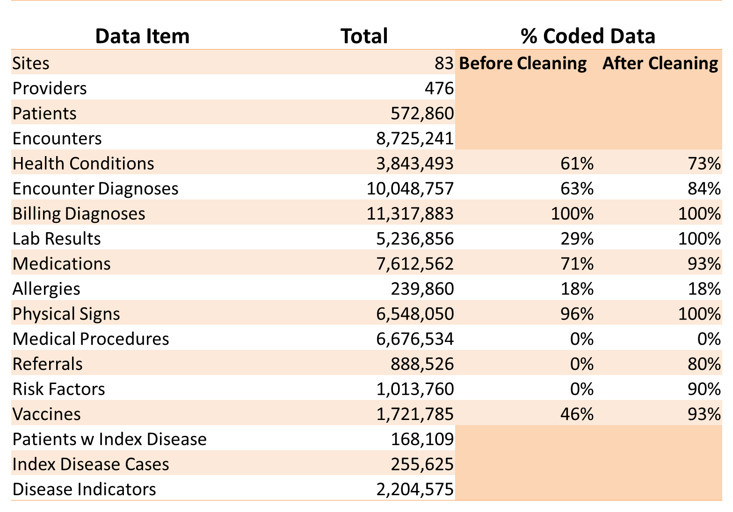
Data Coding/Cleaning Results

Slide 33
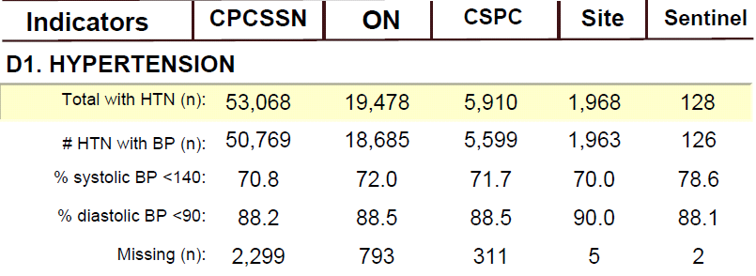
1. Practice Population Management

Slide 34
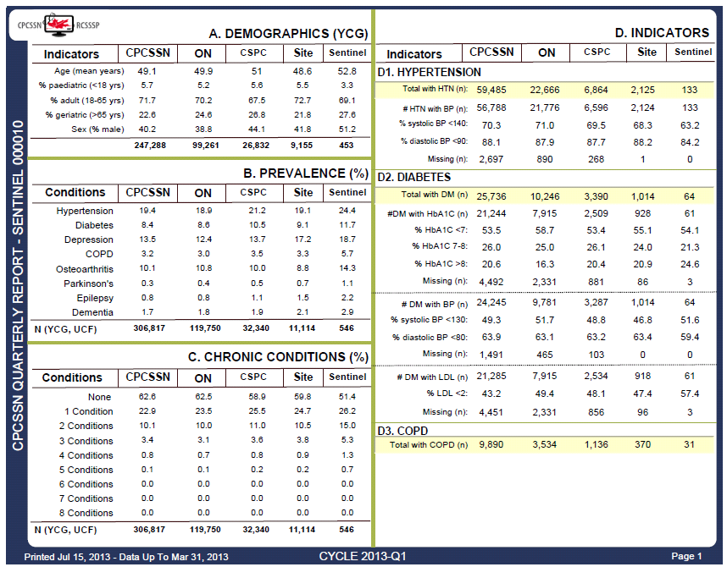
1. Practice Population Management

Slide 35
Web-Based Quality Improvement Tools
InQuIRE: Interactive Quality Improvement Reporting Environment
DPT: Data Presentation Tool
Secure web applications, accessible from clinician’s computer
 | Summary of patient panel | Compare with rest of site and BC | Interactive filtering | Detailed search, patient-level | Save reports for re-use | Re-ID capability
InQuIRE | + | + | +
DPT | + | + |  | + | + | +

Slide 36
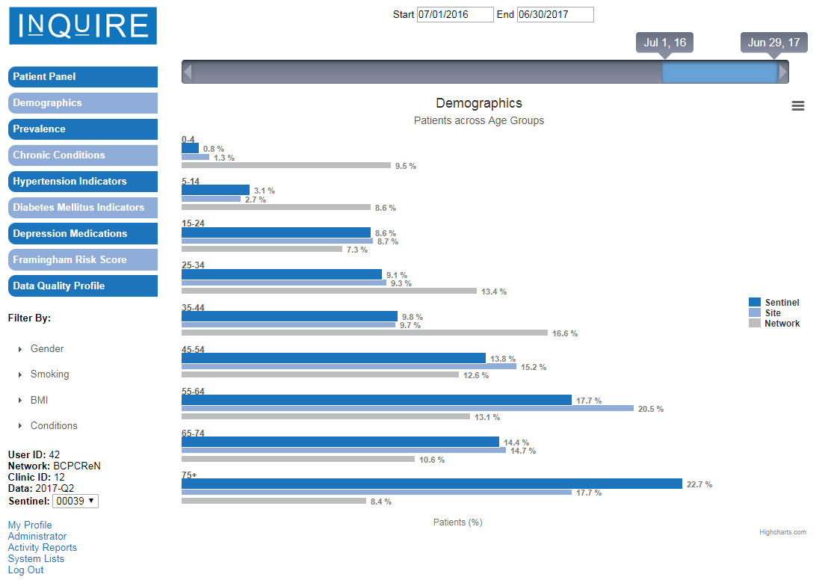
InQuIRE – Demographics (Intrahealth clinic)

Slide 37
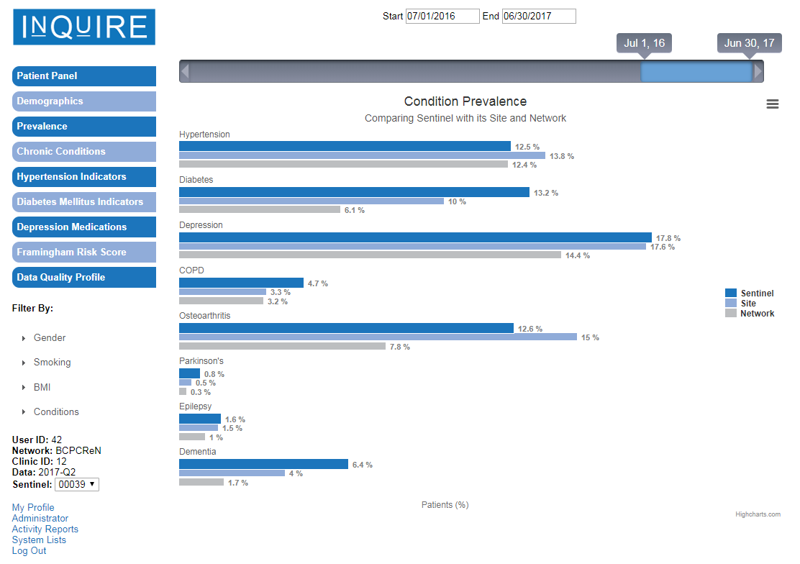
InQuIRE – Prevalence (Intrahealth clinic)

Slide 38
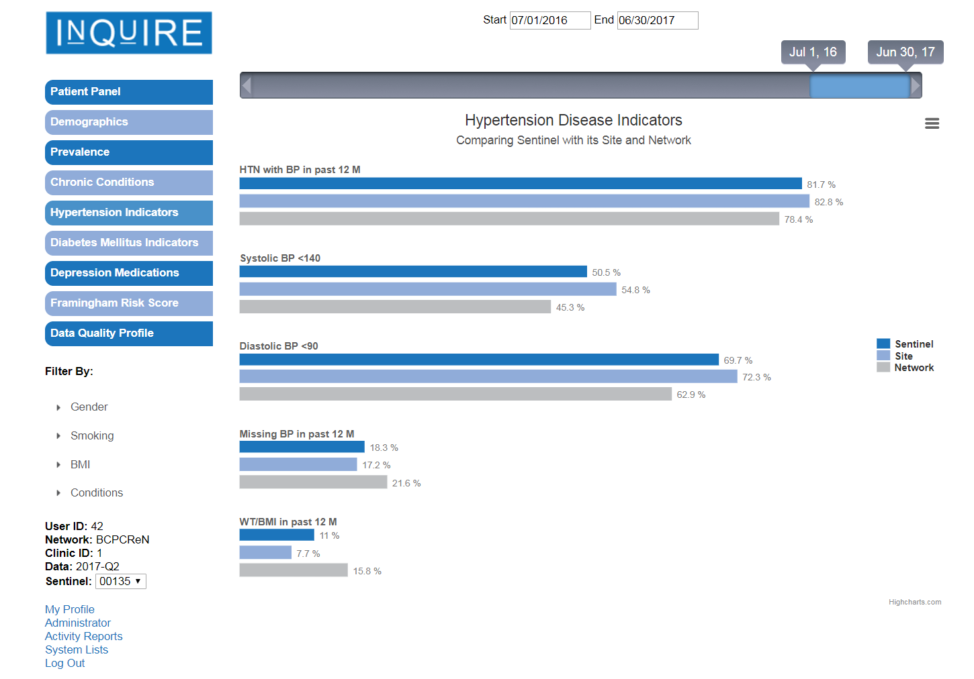
InQuIRE – Hypertension indicators

Slide 39
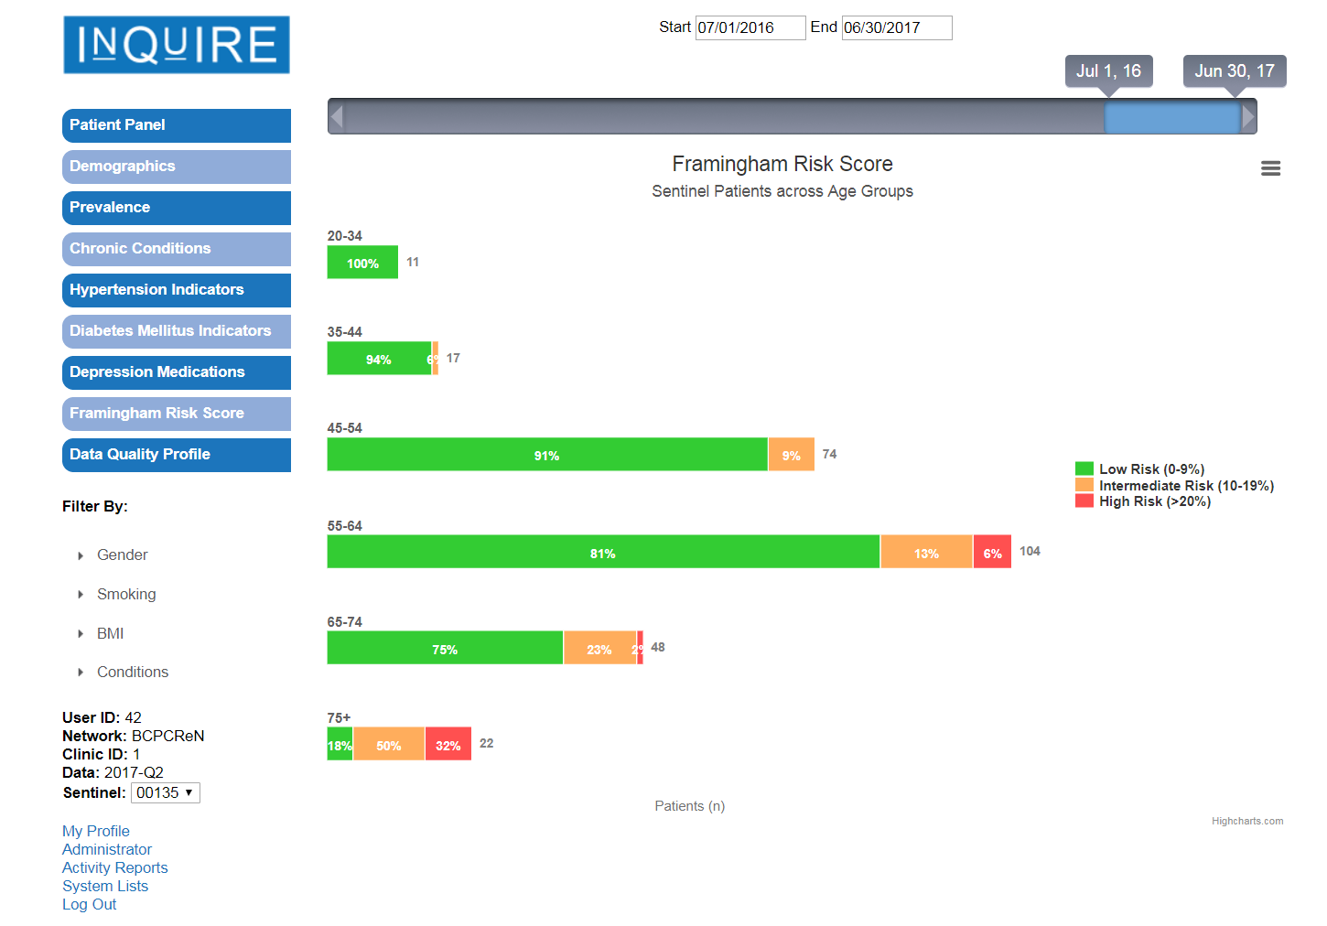
InQuIRE – Framingham risk score

Slide 40
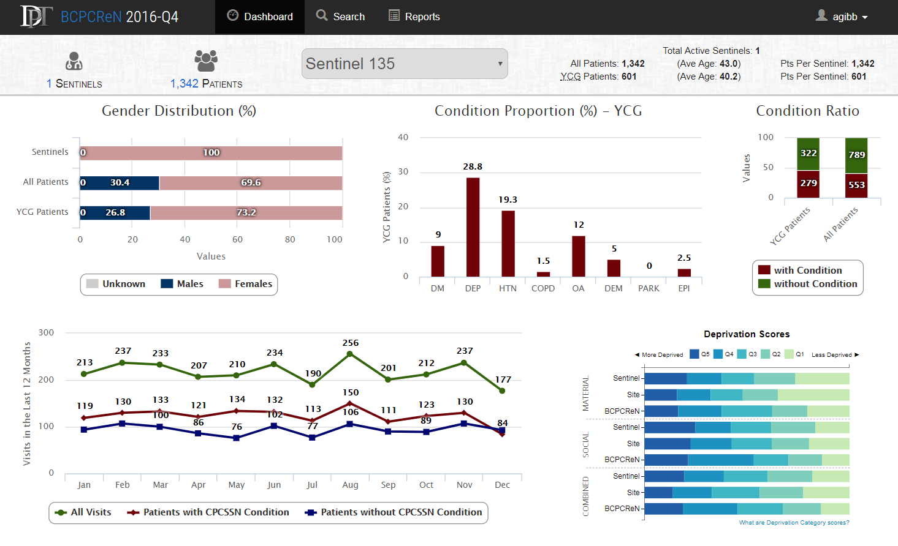
DPT – dashboard

Slide 41
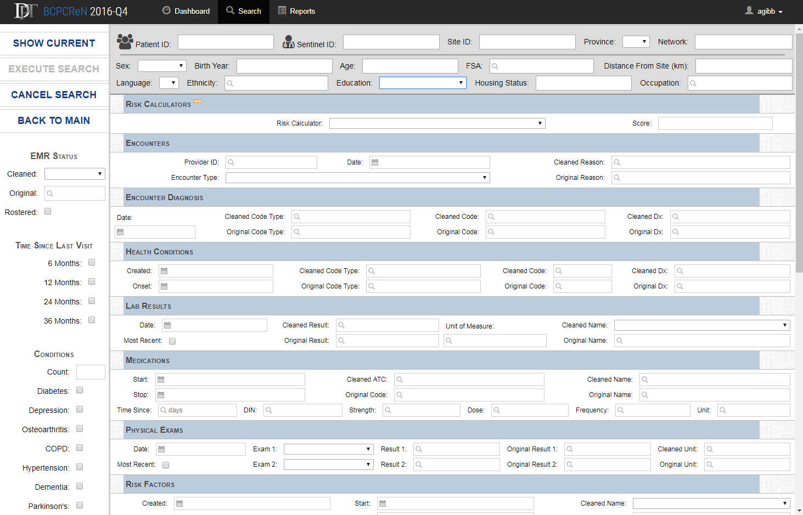
DPT – detailed search

Slide 42
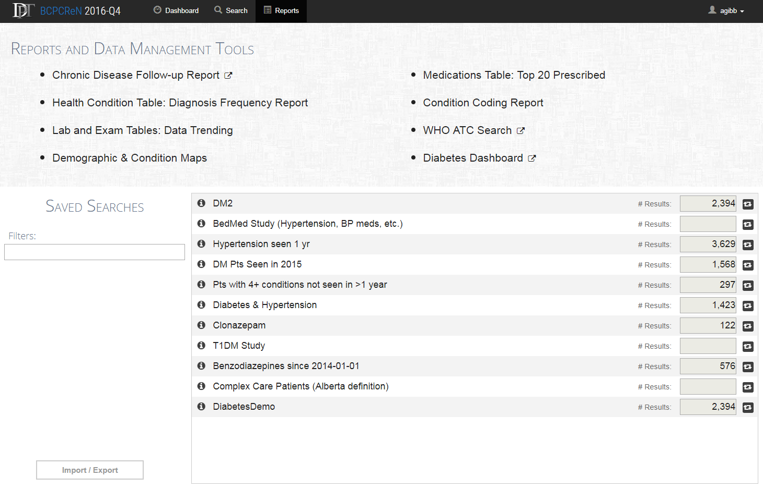
DPT – reports and saved searches

Slide 43
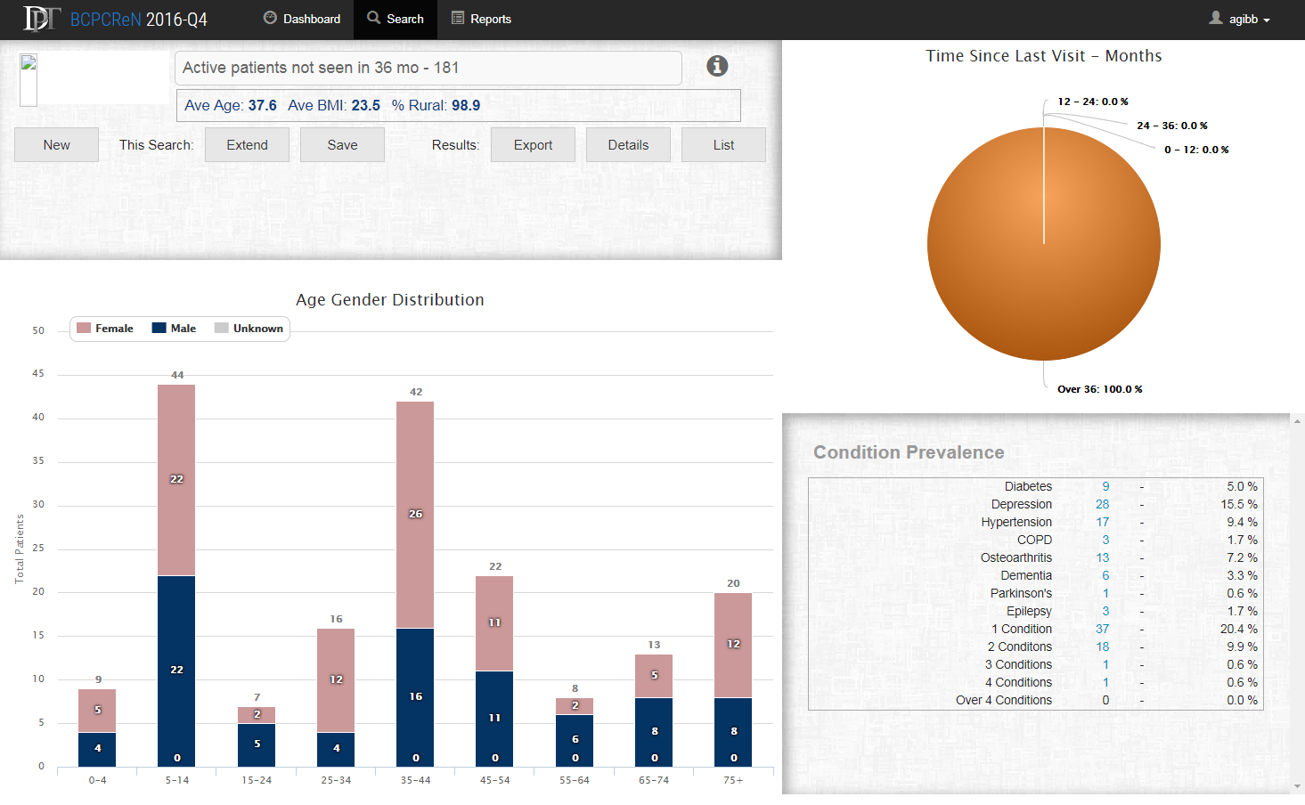
DPT – search for active patients not seen in 3 years

Slide 44
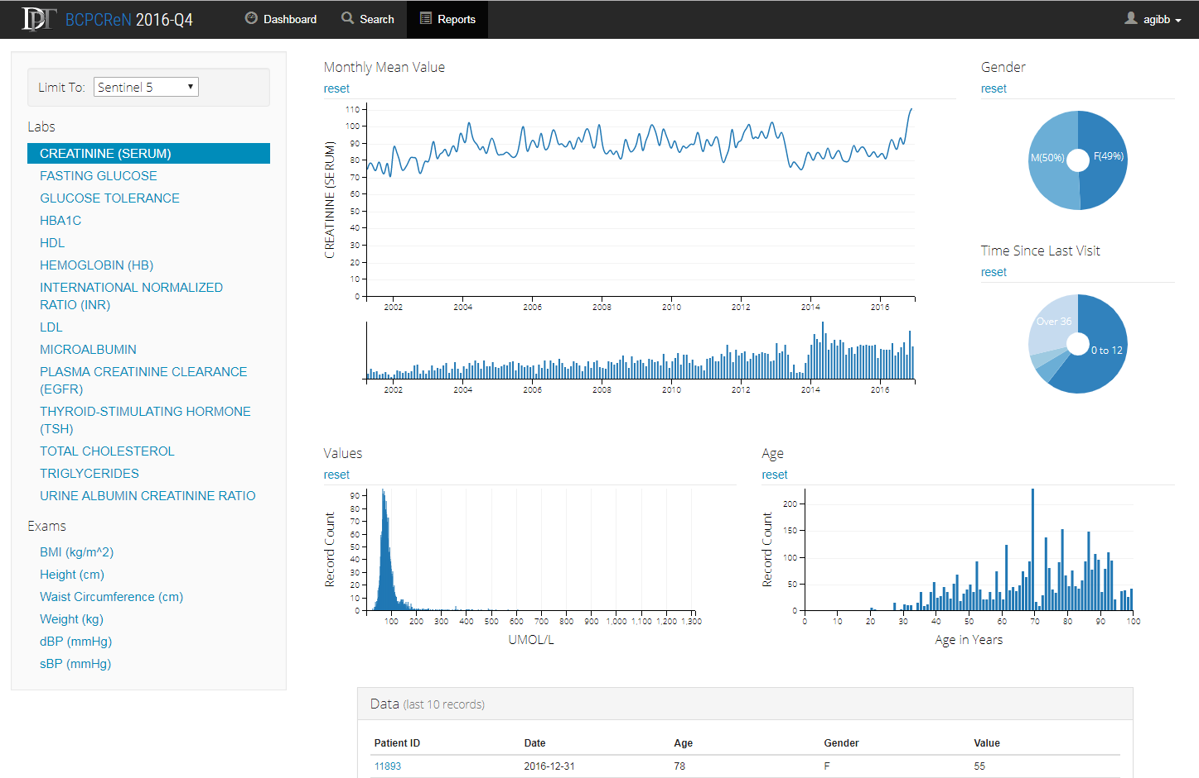
DPT – Trends in lab/exam results

Slide 45
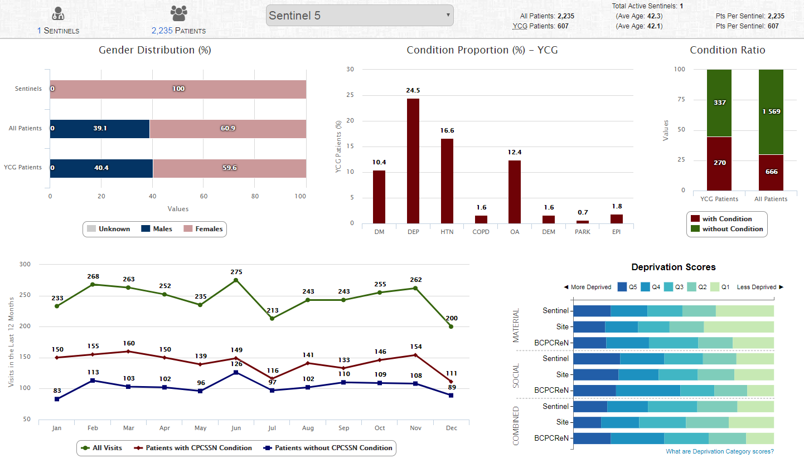


DPT – re-identifying patients
CPCSSN database
Internet
DPT in web browser
CPCSSN data
Encrypted
CPCSSN
mapping file
Read into web
browser
Decryption key
Clinician’s
computer
EMR ID, Name, Address, PHN, …
…..
…..
…..
…..
Patient details

Slide 46
Engaging clinicians through Divisions of Family Practice
Participate in and support projects meant to increase continuity of care:
  Information and management continuity between primary care and health authorities (CWL, IHA-KB project)

Slide 47

Centralized Waiting Lists: Chilliwack and Whiterock Divisions
Analyze the centralized waiting lists implemented in seven Canadian provinces and identify characteristics to promote attachment of complex patients to primary care providers
Make recommendations on ways to improve the design of centralized waiting lists.

Slide 48
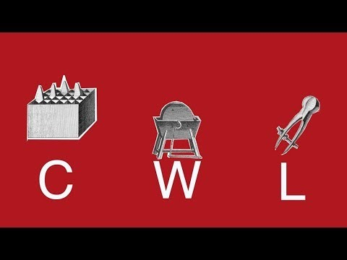
Centralized Waiting Lists – Outcomes
Recommendation by Division to BC MoH for core funding
Best practice from BC implemented in other jurisdictions (e.g. NS, ON)
Video creation [insert URL here]

Slide 49


Creating a Learning Health System and Increasing Continuity of Care
Kootenay-Boundary/Interior Health Authority
Primary Care EMR + Organizational Survey + Administrative data
  Hospital Records
  Emergency Department Records
  Social Determinants of Health (e.g. neighbourhoods, income, education)

Slide 50
Engaging clinicians through Divisions of Family Practice
Participate in and support projects meant to increase quality of care:
  Regional performance measurement; practice based reports using patient medical home framework (TRANSFORMATION)

Slide 51
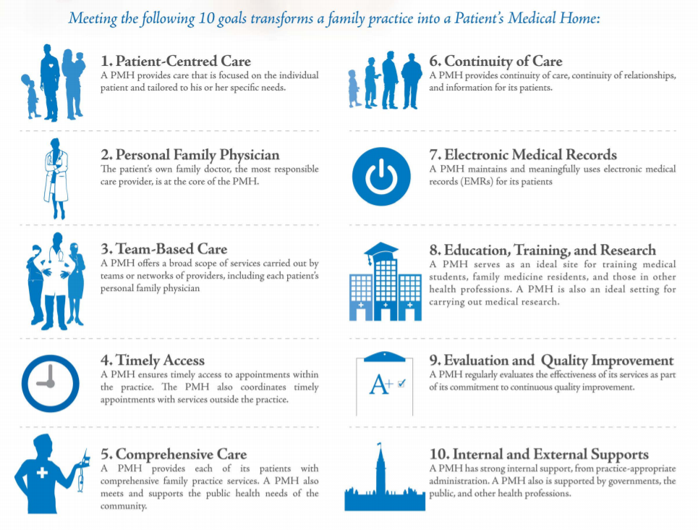
Portrait of Performance in Primary Care
The Patient’s Medical Home (PMH) is the CCFP’s vision for what the future of family practice in Canada will be. The information provided in this portrait shows results in three regions: Central Zone, NS; Fraser East, BC, and Easter ON Health Unit, ON. Cross-provincial regional reporting allows decision makers to reflect on strengths/weakness in primary care that may be shaped by different provincial/regional policies.
Create regional level performance portraits using data from quantitative (surveys, administrative data such as billing codes) and qualitative (document review, interviews, focus groups) sources
We link the information from these different sources to show how practices perform on some elements of the key pillars of the PMH: patient-centred care, team-based care, and electronic medical records.

Slide 52
Definitions of Dimensions
Relationship-based care: The clinicians demonstrate whole-person knowledge of their patients, are willing to talk about sensitive issues and listen well during visits.
Promoting health: Patients receive health advice and health promotion appropriate to their life context, and the staff actively encourages patients to attend groups or classes to help manage their health concerns.
Self-management support: For patients undergoing treatment. Clinicians engage in shared decision-making with patients receiving treatment and patients consistently report feeling better enabled to stick to treatment and care for their health.
Equity orientation: Patients experience respectful treatment from front office staff and clinicians respect the patient’s time, autonomy and dignity and protect low-income patients from incurring additional payments or having unmet needs due to cost
(n=504 patients. 22 clinics)
(n=547 patients, 26 clinics)
(n=878 patients, 39 clinics)

Slide 53
Contextual information: Innovations in interprofessional teams
  ON has implemented the most extensive interprofessional teams of three study regions. BC and NS are moving towards more interprofessional teams, with adoption of the Patient’s Medical Home (BC) / health home (NS) models.
  “So I have to go at one place, you know, my needs are taken care of right there. Everybody knows everything.” [ON patient]
  “When we started looking around the province, there's collaborative practice teams all over the province, except in the densely populated areas. So we have a misaligned sort of distribution right now.” [NS key informant]
Examples of interprofessional teams in comprehensive primary care practices
British Columbia: Fraser East | Ontario: Eastern Ontario Health Unit | Nova Scotia: Central Zone
1 Community Health Centre (CHC) in Fraser East / 29 in the province | CHCs: 5-7 CHCs in EOHU / 74-87 in the province Family Health Teams (FHTs) were implemented in 2004. 2 in EOHU / 184 in province Nurse practitioner (NP)-led clinics were first implemented in 2007 1 in EOHU / 27 in province | CHCs: 2 in Central Zone / 25 in the province Community Health and Wellness Centres: 2 in Central Zone / 2 in province Collaborative Emergency Centres (CECs), were first implemented in 2011. 2 in Central Zone / 8 in province

Slide 54
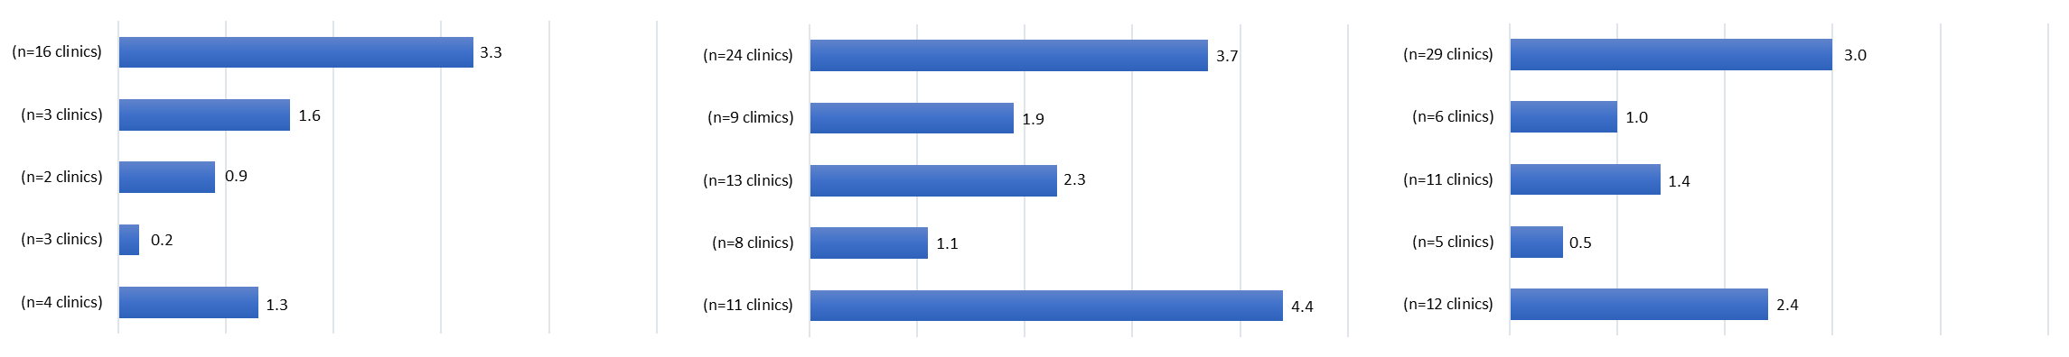
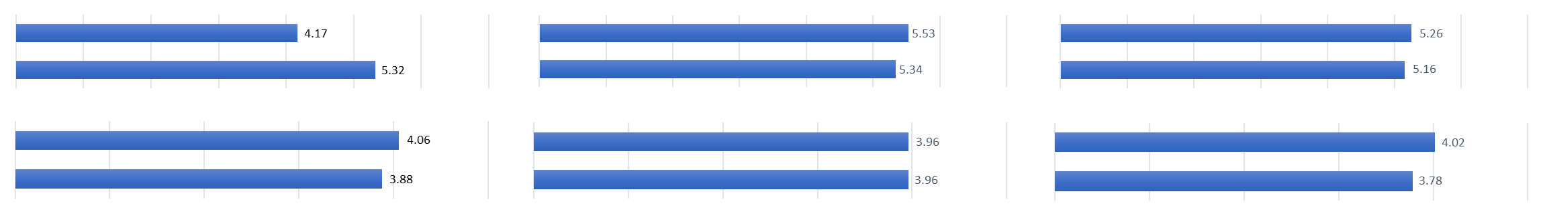
PMH Pillar: Team-Based Care
Fraser East, BC (n=22)
Eastern Ontario Health Unit, ON (n=26)
Central Zone, NS (n=39)
Health Professionals in PC Clinics (Mean FTEs)
Family physicians
Nurse practitioners
Registered nurses
Dieticians
Other
The ON region: higher average FTE for all types of health professionals working in primary care.
Team Effectiveness (Mean Scores)
(n=20 clinics)
(n=21 clinics)
(n=22 clinics)
Participation in the team
Support for new ideas
Team objectives
Task orientation

Slide 55
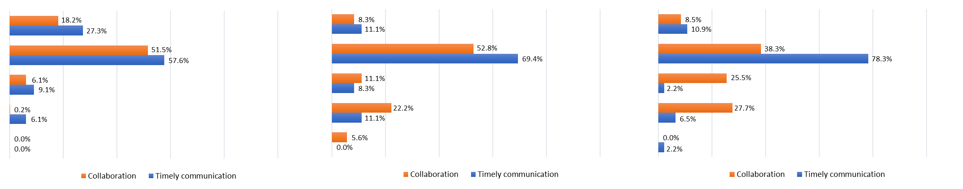
PMH Pillar: Team-Based Care (cont’d)
Fraser East, BC
Eastern Ontario Health Unit, ON
Central Zone, NS
Extent of ability to work with multiple providers outside clinic for care of complex patients
Very great extent
Some extent
Undecided
Not really
Not at all
When clinicians work with multiple providers outside of their clinic for complex patient care, clinicians across all regions reported being better able to have timely communication than effective collaboration.
More clinicians in the BC region reported that having a ‘very great extent’ of ability to collaborate and communicate in a timely manner with other clinicians for complex patient care.

Slide 56
Contextual information: Innovations in information technology
  EMR implementation is high; variation in functionality within PC practices and across PC systems.
  Data privacy issues impact the potential uses for such systems “…to the point where you can’t share information to get best outcomes.” [BC key informant]
  Personal health records are still in an early stage of implementation across the three regions.
  Telehealth and other health information technologies are also being used within the study regions to a limited extent
Examples of innovations in information technology within PC practices
British Columbia: Fraser East | Ontario: Eastern Ontario Health Unit | Nova Scotia: Central Zone
The Physician Information Technology Office (PITO) (2006) is responsible for facilitating general practitioners and specialists in the implementation of information technology (IT). | OntarioMD (ONMD) and eHealth Ontario support physicians moving from paper records to electronic medical records (EMRs) and electronic health records (EHRs) | The Frailty Portal supports physicians to assess and care for patients with frailty through a web-based tool The PHC Information Management and Electronic Medical Records (PHIM) project supports EMR implementation for the province.

Slide 57
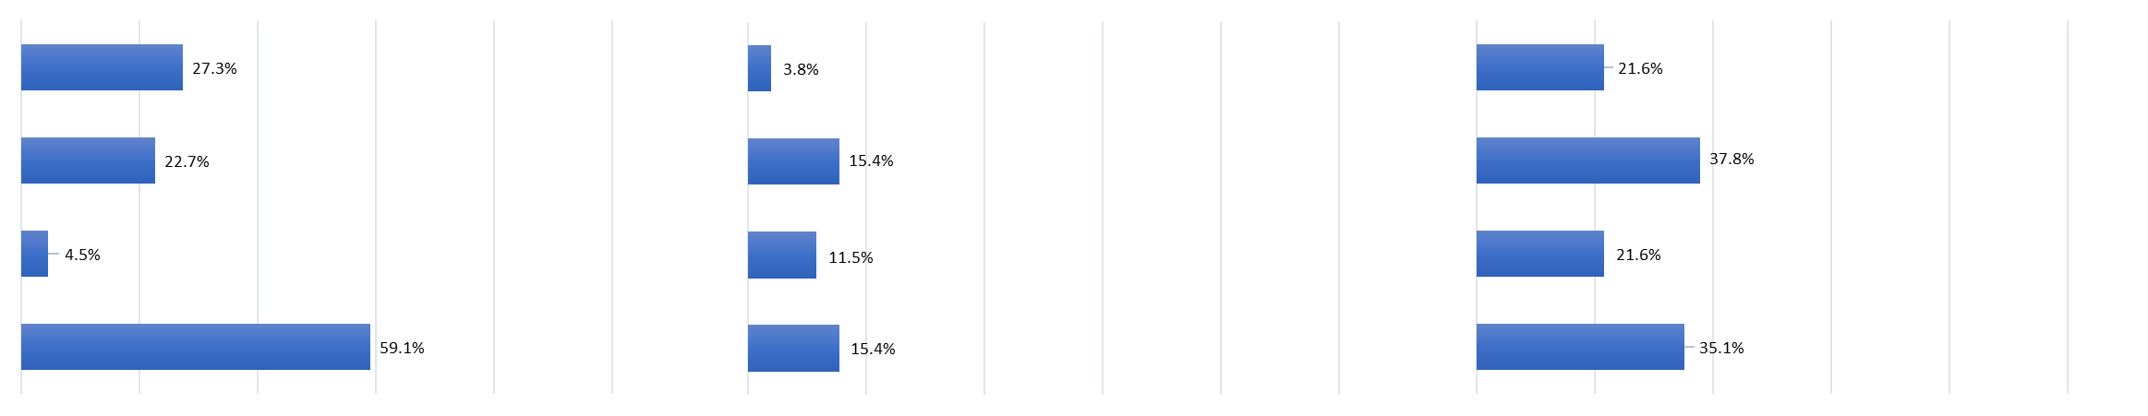
PMH Pillar: Electronic Medical Record
Fraser East, BC
Eastern Ontario Health Unit, ON
Central Zone, NS
Information technology
Patients have the option to...
Request appointments or referrals online
Send a medical question/ concern via email
Request refills for prescriptions online
View test results on a secure website
(n=22 clinics)
(n=26 clinics)
(n=37 clinics)
Clinics in the ON region reported having less functionalities for patients to access IT services at their clinics.
Clinicians in the BC and ON regions (mostly) use EMRs in their clinics; 83% of clinicians used EMRs in the NS region.

Slide 58
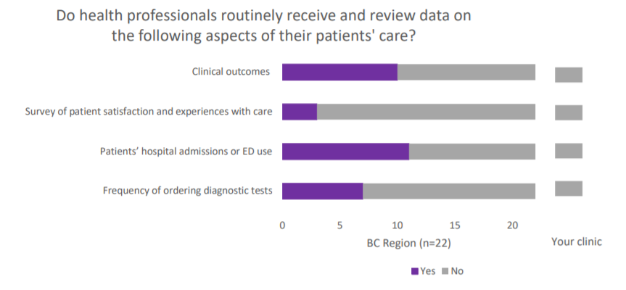
Organizational adaptiveness

Slide 59
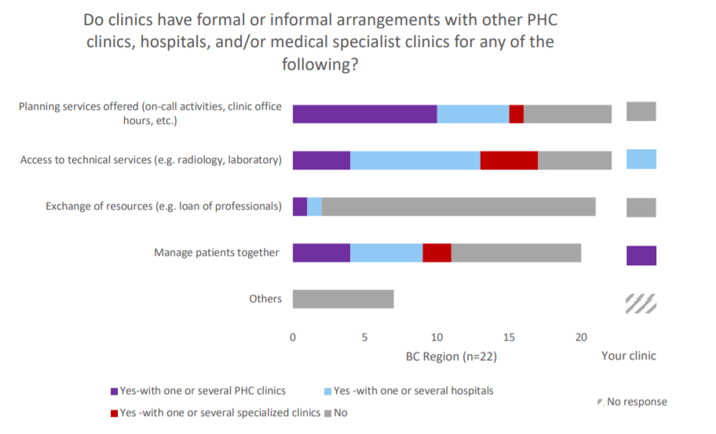
Practice Integration

Slide 60
BC PHCRN: Engaging Clinicians
Divisions of Family Practice: Whiterock, South Surrey, Chilliwack, Abbotsford, Mission/Hope, Kootenay-Boundary, North Shore
  Projects of interest to membership, value add
GPSC:
  Input on support for various projects
Various clinicians:
  QI tools
https://twitter.com/home: @BC_PHCRN

